Slide 1

watsonx.ai Train, validate, tune and deploy AI models Client presentation Lindsay Wershaw Lindsay.Beth.Wershaw@ibm.com Senior Product Marketing Manager, IBM watsonx.ai Angela Jamerson Angela.Jamerson@ibm.com Program Director, Product Management, watsonx.ai Felix Lee felix@ca.ibm.com Principal, Learning Content Development, AI and Data Anshupriya Srivastava anshupriya.srivastava@ibm.com Advisory, Learning Content Development, AI and Data
Notes:
Watsonx is a new artificial intelligence (AI) and data platform from IBM that is designed with the three critical elements of an AI strategy in mind: AI, data, and governance. It empowers enterprises to train, validate, tune, and deploy AI across their business, leveraging critical, trusted data wherever it resides. This platform has three components that map to the three critical elements of AI platform needs: watsonx.ai, watsonx.data, and watsonx.governance
The focus of this presentation is on watsonx.ai, a studio that clients can use to train, validate, tune, and deploy both machine learning (ML) and traditional AI models, as well as foundation models (FMs) for generative AI. These models combine best-of-breed architectures with a rigorous focus on data acquisition, provenance, and quality, to serve enterprise needs.

Slide 2
Contents
Introduction
Generative AI and traditional AI
Foundation models and generative AI
Impact of generative AI
Five truths of generative AI
Common generative AI tasks
Risks and requirements for a generative AI platform
Watsonx and watsonx.ai
IBM watsonx and its components
IBM watsonx.ai
Train, validate, tune, and deploy AI models
IBM watsonx.ai components
Foundation models library
Prompt lab
Tuning studio
Synthetic data Generator
Watsonx.ai value propositions
Getting started with watsonx.ai
Notes:
This self-explanatory slide provides an agenda for this presentation.

Slide 3
...but how enterprises adopt and execute will define whether they unlock, create value, unleash innovation at scale and with speed
Foundation Models and Generative AI
are bringing an inflection point in AI...
Notes:
Foundation models (FMs) are different from traditional AI models. While traditional AI models require supervised training on labeled data, FMs use self-supervised training on a large pool of unlabeled data and do not require labeled data. Supervised learning is human-powered, requires intense labeling, and is long, hard, and expensive. Self-supervised leaning is computer-powered, requires little labeling, and is quick, automated, and efficient. (See backup slide for more details on the difference between supervised and self-supervised learning.)
What ChatGPT has done is to popularize the technology and showed some of its potential. FMs, in particular large language models (LLMs) are good at many things. Specifically, they
Are good at performing question and answer (Q&A) tasks – users can raise random questions at ChatGPT and get pretty good answers.
Can summarize a large body of texts.
Can generate new content like a story and can be instructed to write in a particular style.
Excel at general natural language processing (NLP) tasks.
But FMs can so much more, ranging from various NLP tasks like summarizing, extracting, Question and answering, code generating, and for general usage, to domain-specific applications in finance, cybersecurity, and much more. Given their remarkable performance and extensibility to a wide range of tasks, is bringing an inflection point in AI. How businesses adopt FM and execute generative AI will have a significant impact on future success.
It will determine:
Whether businesses can unlock value from FM and generative AI
Whether businesses can create value for their customers
Whether businesses can create and unleash innovation at scale with speed to their value customers, and to leap ahead of competitions

Slide 4
Generative AI and traditional AI
Both traditional AI and generative AI are useful for enterprises.
Neither replaces the other, generative AI opens new possibilities
Generative AI
Foundation models trained with unlabeled data
Unsupervised
Trained on very big data sets
No specific task
Transferable
Works well for general tasks and can improve for specific tasks with less training
Need to monitor bias and drift
Traditional AI
Traditional Machine learning (ML/AI) model trained with “labeled” data
Training is supervised
Trained on proper, large data sets
Trained for a specific task
Does not transfer well to other tasks
A tuned model can be very efficient for the specific task it was designed for
Need to monitor bias and drift
Notes:
This slide contrasts traditional AI with generative AI.
First – it is important to point out that generative AI and traditional AI are both useful for companies. Clients do not have to choose between generative AI and traditional AI – both have their place and are useful for enterprise use cases. Clients do not need to give up their existing investment in traditional AI. Generative AI simply opens-up new possibilities for clients.
Generative AI
Generative AI is built on a foundation model (FM). For example, ChatGPT is trained on a large language model (LLM) which is a particular type of FM specialized for natural language processing (NLP). The difference is that FMs do not require labeled data to train.
Generative AI uses unsupervised learning.
Training an FM requires a huge amount of data (think of traditional AI as training a person to be a biologist, or a chemist, whereas a FM would be like training someone to be a scientist who knows something about many scientific areas). This is why generative AI is difficult – it requires a massive amount of data and resources to train as the number of parameters is easily into hundreds of billions.
Most of these models are not trained for any specific tasks. Generative AI has what is referred to as emergent behaviors – a property of FMs in which the model exhibits behaviors there were not explicitly constructed.
FMs are therefore “general models” and are easily transferrable among different tasks as it has a very broad base. This broad base training allows generative AI models to work fairly well with general tasks. They do not work as well for specific tasks as traditional AI models (that were trained for specific task or tasks). However, they can be further trained with a much smaller set of labeled data for it to improve.
An enterprise can take an existing FM (such as GPT) and specialize it for their use with much less effort. However, it is also more important to monitor for bias and drift as there is a huge base model that is much harder to understand, control, or govern.
Traditional AI
These are typical machine learning (ML) and AI models trained with a lot of labeled data. This is a human-intensive and time-consuming task.
Training is typically supervised for best results. Users must constantly monitor, feedback, and retrain.
Typically trained on large data sets – and they will need to be properly labeled.
Traditional AI with labeled data is targeted for a specific task – summarizing log records to catch specific items, responding to human resource queries, and others.
With traditional AI, clients can get transferability with their models (through a process called transfer learning) but this is a tedious task that involves re-training the entire and using newly labelled data it has not seen before. Traditional AI models, therefore, do not transfer well/easily to work with other tasks.
For the task, the model was trained on (and for the particular enterprise) these AI models work very efficiently.
AI model needs to be monitored for bias and drift to ensure that the model remains relevant.

Slide 5


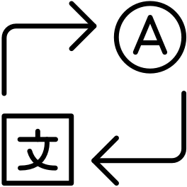

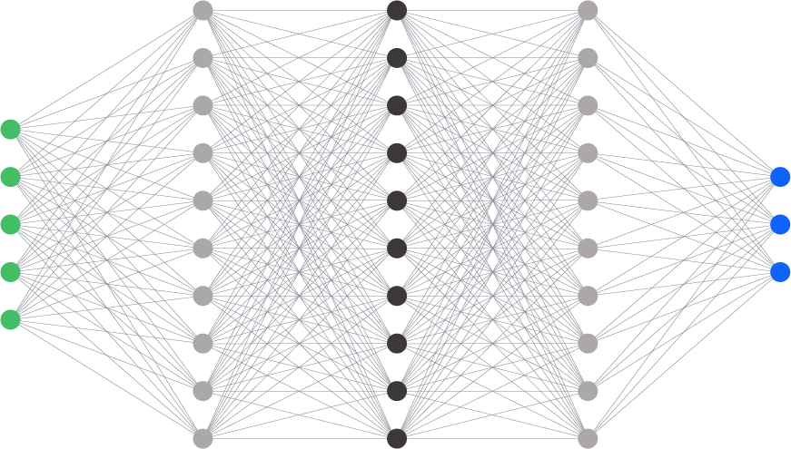


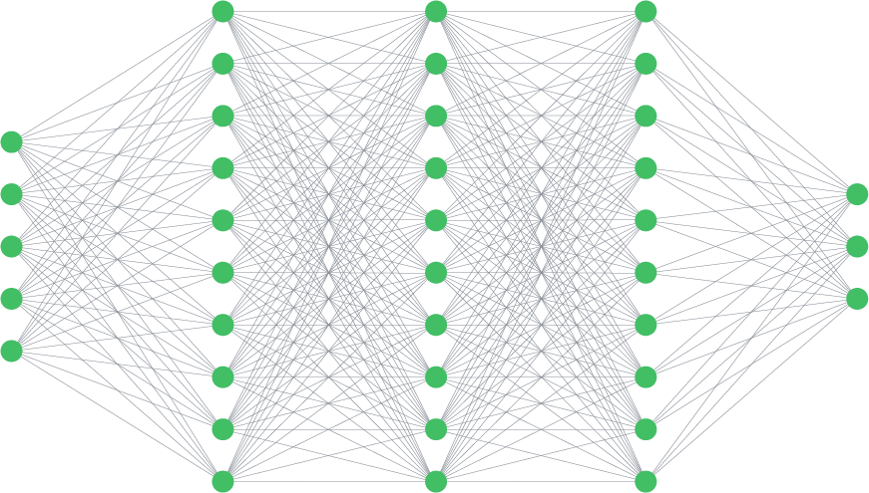
Foundational models enable a new paradigm of data-efficient AI development – generative AI
Traditional AI models
Foundation Models
Training with labeled data
Tasks
Tasks
Model₁
Massive unlabeled external data
Prompting
Q&A
Summarization
Model₂
…
Model₃
Pre
Trained
Tuning
Prompt-tuning
Differentiation via training with enterprise data
Model₄
+ Enterprise proprietary data
Fine-tuning
Foundation model
Individual siloed models
Require task specific training
Lots of human supervised training
Rapid adaptation to multiple tasks with small amounts of task-specific data
Pre-trained unsupervised learning
Notes:
This slide illustrates why generative AI built on foundation models provide advantages over traditional AI.
On the left is how traditional AI is built.
Traditional Ai requires:
Individual siloed models. For every task, a particular AI model is typically built on a particular set of labeled data.
Task-specific training for each model and its training is not generally transferable (at least not easily without re-training with a completely different set of data). It can be very time-consuming when there are a lot of tasks (even if they are somewhat similar)
Lots of human effort and cost is spent on labeling data alone.
Given that an enterprise will require hundreds to thousands of automated tasks, this is very expensive and is often why AI adoption stalls from incubation to production.
On the right is how generative AI is built.
Unlike traditional AI, foundation models (FMs) do not begin with labeled data but are pre-trained on massive amounts of data. Specifically:
Instead of building each model for a specific task, FMs are massive multi-tasking models that can be applied to many different tasks.
FMs are adaptable with little or no training to support a multitude of different tasks.
These models are pre-trained and require no supervision. Due to the amount of data used, training massive FMs may require a lot of Graphical Processing Units (GPUs) and memory, but FMs do not need the large and costly human capital required to come up with specific labeled data for various tasks.
FM models:
Are built to be very capable as is. These can be used to support many lower-level, less specific AI tasks.
Allow clients to modify the prompt to optimize and train the model on desired behavior and output
Can also be domain-specific, such as models built on financial data, cybersecurity data, geospatial data, etc. These are much more capable of supporting more specific tasks – again, without much intervention or input. IBM plans to provide these domain-specific models based on the best sets of data available.
Generative AI platforms (such as IBM watsonx.ai) typically offer a selection of FMs (open-source and proprietary)
FM models support many tasks that are either not possible or much more difficult to achieve with traditional AI. They provide enhanced capabilities for many Natural Language Processing (NLP) tasks (up to 70% reduction in certain tasks) such as:
Summarization of text
Conversational knowledge
Content generation (email, etc.).
Question answering
Clients can customize and train their FMs with their own data to support the specifics they require (for example, unique business terms and proprietary data).
With IBM watsonx.ai, clients always own the data and any model they train. The key takeaways are that FMs:
Take much fewer resources and labeled data to train (versus traditional AI)
Can be easily used for multiple, similar tasks with no training, or with very little training, via a different set of labeled data.
Help clients turn around new AI models based much quicker, with a lot less overhead than ever before.
Can be trained with the business’s data, and they can provide true differentiation based on the quality of domain-specific data.

Slide 6
Impact of generative AI Scale of impact points to swift adoption over next 3 years
Global economic boost
Massive early adoption
81%
of enterprises are working with or planning to leverage foundation models and adopt generative AI
Broad-reaching and deep impact
7%
Potential rise in global GDP within 10 years
Critical focus on AI investment
70%
of software vendors will integrate Gen AI in their enterprise applications by 2026
$3-4T
forecasted economic benefits to the global economy across industries
Sources: Mckinsey; Goldman Sachs; IBM Institute for Business Value; Gartner. Scale Zeitgeist: AI Readiness Report, a survey of more than 1,600 executives and ML practitioners
Notes:
Even though generative AI is relatively new, the widespread popularity of ChatGPT has created significant interest in the notion of large language models (LLMs) and foundation models (FM) and what they can do. It took quite some time for enterprises to start moving towards traditional AI. In contrast, generative AI has a massive early adoption: 81% of enterprises are already working with, or planning to leverage, FM and to adopt generative AI in their use cases and workflow.
Moreover:
Mckinsey’s latest research has indicated that generative AI could add the equivalent of $2.6 trillion to $4.4 trillion annually across the 63 use cases they analyzed.
Scale Zeitgeist 2023 AI Readiness Report shows that with the companies they reviewed, 21% have generative AI models in production; 29% are experimenting with generative AI and another 31% planning to work with generative AI models; a total of 81% are either working with or planning to work with generative AI models.
Goldman Sachs has estimated that generative AI will have a very deep economical impact – raising global Gross Domestic Product (GDP) by 7% within 10 years – which reflects its huge potential.
Gartner predicts that around 70% of independent software vendors (ISVs) will have embedded GenAI capabilities in their enterprise applications by 2026, a major jump from fewer than 1% today
All these data point to the extremely high adoption trend for generative AI.
It’s great for consumer applications and there are some business applications it will help too, but the discussion should really be about what is the technology that's going to help businesses move forward.
Sources:
Mckinsey on generative AI’s trillion-dollar contribution: https://www.mckinsey.com/capabilities/mckinsey-digital/our-insights/the-economic-potential-of-generative-ai-the-next-productivity-frontier#key-insights
Goldman Sacks on generative AI could raise global GDP by 7%: https://www.goldmansachs.com/insights/pages/generative-ai-could-raise-global-gdp-by-7-percent.html
Gartner on generative AI: https://www.gartner.com/en/topics/generative-ai#:~:text=We%20predict%20that%20by%202025,marketing%20copy%20and%20personalized%20advertising.
Scale Zeitgeist: AI Readiness Report, a survey of more than 1,600 executives and ML practitioners: https://go.scale.com/hubfs/Scale-Zeitgeist-AI-Readiness-Report-2023.pdf

Slide 7
Five truths of generative AI
Truth 1
Multi-model
Truth 2
Truth 3 Governance
Truth 4
Scale for value
Truth 5
Data matters
Multi | hybrid cloud
Two thirds of 150+ enterprises surveyed report pursuing a multi-model strategy
60% + of enterprises pursuing multi-model are experimental with commercial & open-source models
Commercial & open-source innovation
Quickly prioritize use cases that will outlive the model
Multi-modal (text, image, audio, etc.)
One model will not rule them all
Gartner reports that most enterprises will deploy generative AI across hybrid / multicloud environments
Run where the workflows, apps and data live
Infer where business runs to drive performance, cost, and simplicity
Data location to drive security benefits
Regulatory compliance to influence location selection
Surveyed companies report governance as a top requirement, impact of generative AI makes governance more difficult
Businesses must control bias and monitor drift
Organizations must actively monitor hallucinations and ensure model explainability
Leaders must seek practices and tools to ensure model and data provenance
Critical to pick the right use cases and deployment for generative AI ROI
Different work tasks have strongly positive or negative ROI impact
Time savings for a meaningful product innovation +40%; business problem solving -23% time needed
60+ points difference in value for work tasks
25x difference in cost per inference, depending on model and deployment
Generative AI pilots have not made it to production due to challenges with data quality, access, and security
Short run: model innovation creates value
Long run: data quality will decide which enterprises win with generative AI
Notes:
Organizations are increasingly turning to generative AI solutions to gain a competitive edge and unlock new opportunities. As AI adoption accelerates across enterprises, it becomes increasingly crucial to navigate the landscape carefully and responsibly.
Implementing AI is a complex process that requires careful planning and consideration. Businesses must ensure they integrate with existing systems, select the right AI models, consider ethical implications, define the problems they want to solve and scale, and ensure that their data is of high quality.
The five truths of generative AI:
Multi-model - In a survey of more than 150 enterprises, it was found that a significant majority (two-thirds) are adopting a multi-model approach, blending various types of business models. A notable 60% of these companies are not only experimenting with this strategy but are also integrating a mix of commercial and open-source models. The focus for these enterprises is on fostering innovation through this hybrid approach and quickly identifying use cases that will provide long-term value, regardless of prevailing trends. These efforts are not limited to single-mode operations but span across multiple modalities, including text, image, and audio technologies, highlighting a recognition that no single model will be universally superior or applicable across different business scenarios.
Multi/Hybrid cloud – Gartner’s reports have indicated that most businesses are likely to implement generative AI technologies within hybrid and multicloud frameworks. This strategic deployment is aimed at executing AI processes directly where the essential workflows, applications, and data reside. The objective is to perform AI inference at the heart of business operations to optimize performance, manage costs, and simplify processes. Additionally, data location is becoming increasingly strategic for enhancing security measures. Furthermore, the choice of data location is being influenced by regulatory compliance demands, suggesting that legal and privacy considerations are key factors in deciding where to physically or virtually house business data and AI operations.
Governance - The surveyed companies recognize governance as a crucial element when deploying generative AI, although the complex nature of generative AI makes establishing effective governance more challenging. To address this, businesses must implement measures to mitigate bias and continuously monitor for model drift to ensure the AI's decisions remain valid over time. Furthermore, organizations are tasked with vigilantly detecting any 'hallucinations'—instances where AI generates false or nonsensical information—and to prioritize the explainability of their AI models. This includes the ability to trace the reasoning behind decisions and predictions. Leadership within these companies is urged to adopt practices and tools that verify the origins and history of both the data and the models (provenance) to maintain transparency and accountability.
Scale for value - Selecting the appropriate use cases and deployment strategies is essential for maximizing return on investment (ROI) with generative AI. The impact on ROI varies greatly depending on the work tasks automated by generative AI—some tasks yield a substantial positive ROI, while others may have a negative impact. For instance, leveraging generative AI can lead to a 40% increase in time saved when it comes to meaningful product innovation, whereas time needed for business problem-solving can be reduced by 23%. The variance in value generated by different work tasks can exceed 60 points, indicating a significant disparity in potential benefits. Moreover, the cost per inference can vary by up to 25 times, which is influenced by the choice of model and the specific deployment approach. This highlights the importance of strategic decision-making in the application of generative AI to ensure cost-efficiency and value creation.
Data matters - The transition from generative AI pilot programs to full production has been hindered by issues concerning data quality, accessibility, and security. In the short term, the innovative capabilities of generative AI models are recognized for their potential to create immediate value for enterprises. However, in the long term, it's the quality of data that is projected to be the determining factor for success. This suggests that those enterprises which can ensure high standards of data quality, making it both robust and reliable, are the ones most likely to reap the benefits and 'win' with generative AI technologies.
Acronym:
ROI: Return on Investment
Sources:
Truth 1: Source: IBM conducted primary interviews to understand enterprises’ foundation model strategy decisions
Truth 2: Source: Cisco and Gartner
Truth 3: IBM Institute of Business Value
Truth 4: Source: Human-Generative AI Collaboration Experiment (May-June 2023); BCG analysis, Decoding the True Cost of Generative AI for Your Enterprise by Maryam Ashoori, PhD

Slide 8
Most common generative AI tasks implemented today
Summarization
Transform text with domain-specific content into personalized overviews that capture key points.
Conversation summaries, insurance coverage, meeting transcripts, contract information
Classification
Read and classify written input with as few as zero examples.
Sorting of customer complaints, threat and vulnerability classification, sentiment analysis, customer segmentation
Generation
Generate text content for a specific purpose.
Marketing campaigns, job descriptions, blog posts and articles, email drafting support
Extraction
Analyze and extract essential information from unstructured text.
Medical diagnosis support, user research findings
Question-answering
Create a question-answering feature grounded on specific content.
Build a product specific Q&A resource for customer service agents.
Notes:
Generative AI has a lot of applications, this self-explanatory slide shows some of the most common ones encountered today.
Summarization – Take a large body of text (such as meeting minutes, contract documents, etc.) and summarize the key points.
Classification – Read an input and provide classification based on business terminologies and specific categories. This can apply to sentiment analysis, security vulnerability classification, and more.
Generation – The main capability of ChatGPT type chatbot – this generates text content for specific purposes. In the business context, this can be for email drafting, marketing material creation, job posting, etc.
Extraction – Use to analyze and extract essential information. Enterprises now have lots of unstructured data from PDF, Parquet, JSON and other open sources. Generative AI can be used to extract information.
Question answering – generative AI will search documents or other dynamic input to support question and answer applications such as chatbots. This is useful for building a question and answer (Q&A) platform for both external (to find out about specific products or processes to join an early preview) and internal customers (for example, for looking up company policies or processes).

Slide 9
Generative AI adoption considerations, inhibitors and fears 80% of business leaders see at least one of these ethical issues as a major concern
Explainability
Believe decisions made by generative AI are not sufficiently explainable.
Bias
Believe that generative AI will propagate established biases.
Ethics
Concerned about the safety and ethical aspects of generative AI.
Trust
Believe generative AI cannot be trusted.
Source: IBM IBV “generative AI: The state of the market”, June 2023
Notes:
This slide shows some major factors that are inhibiting the adoption of generative AI for business. While businesses recognize its power, about 80% of business leaders do see that there are ethical concerns with adopting generative AI. As a general rule, enterprise concerns can be broken down into the following categories:
Explainability
How to understand and explain a model’s output? This requires an understanding of how the model was created, the training data that was used to fine-tune the model, and who has control and access to update the model. Who might have changed the model for what reasons? There is also the need to understand the type of data used to train the model.
Ethics
There are lots of concerns over ethical issues with generative AI and for good reasons. Companies need to uphold their hard-earned reputation and protect themselves from generative AI models that output hateful, biased, or unethical behavior which would be very damaging to the company, not to mention legal ramifications.
Just because something “works” does not mean it is compliant with many ethics standards (corporate and government), and various government regulations, for example on data privacy.
As generative AI becomes more prevalent, there are likely to be increasingly more regulations. Clients want to work with vendors committed to the highest level of accountability, and responsibility in complying with regulations, and in upholding high ethical standards.
Bias
This is a general issue with all artificial intelligence (AI) models and generative AI is not immune from it. Indeed, because of the way generative AI models are trained and used, it is even more important and at the same time more difficult. There is a fear that generative AI will simply propagate established bias, or even magnify it.
There is a strong requirement that the models must be checked for bias before being released and automatically monitored for bias once released.
Trust
Can generative AI models be trusted? There are two aspects:
Data being entered into generative AI must not be used for any other purpose aside from prompting/training the model.
Outcomes from the model need to be trusted – trained on curated data, explainable, transparent, and monitored.
Without trust, generative AI can be no more than a powerful and interesting chatbot.
Other issues
Hybrid and multicloud capabilities: Clients that need to observe straight data/application locality will need a hybrid platform, and multi-cloud options to avoid vendor lock-in.
Customization: generative AI on foundation models work reasonably well, but not for specific enterprise tasks as enterprises have very specific data, business terms, business processes, and other in-house rules. The first question clients must ask is: “How can the model be adapted to support specific enterprise use cases?” The second question clients must ask is: “What tools are available for the enterprise to hone/train the model?” The AI tools a company depends on must have guardrails, traceability, and transparency.
Clients cannot just simply adopt foundation models that cannot do what they need. Clients need to be able to trust an AI company with their data, reputation, customers, and above all, their businesses.
Source:
IBM IBV “Generative AI: The state of the market”, June 2023

Slide 10
Generative AI adoption barriers Executives highlight three top barriers to implementing generative AI
Cybersecurity
Privacy
Accuracy
53%
51%
47%
Enterprises need more than an AI solution - they need a comprehensive and sound strategy for generative AI.
Source: IBM IBV “generative AI: The state of the market”, June 2023
Notes:
This slide shows some major factors that are a barrier the adoption of generative AI for business.
Cybersecurity - Cybersecurity is a major barrier to adopting generative AI in organizations, primarily due to data privacy, integrity, and vulnerability concerns. Generative AI requires large datasets, which may include sensitive information.
Privacy - Privacy concerns are a significant barrier to generative AI adoption in organizations. Handling sensitive data responsibly, avoiding misuse, and complying with stringent data protection regulations are essential to address privacy risks and build trust in AI-powered systems.
Accuracy – Accuracy issues pose a barrier to generative AI adoption in organizations. Inconsistencies in AI-generated outputs and the risk of generating incorrect or misleading information can lead to distrust and potential operational risks, necessitating rigorous testing and continuous improvement of AI models.
Source:
IBM IBV “Generative AI: The state of the market”, June 2023

Slide 11
Generative AI must be tailored to the enterprise
Open
Trusted
Targeted
Empowering
→ Based on the best AI and cloud technologies available.
→ Offering security and data protection.
→ Designed for targeted for business use cases, that unlock new value.
→ A platform to bring your own data and AI models that you tune, train, deploy, and govern.
→ Giving access to the innovation of the open community and multiple models.
→ Built with Governance, transparency, and ethics that support increasing regulatory compliance demands.
→ Models that can be tuned to your proprietary data and company guidelines.
→ Running anywhere, designed for scale and widespread adoption.
Notes:
This slide highlights IBM’s viewpoint on some vital characteristics of generative AI and foundation models (FMs). Businesses want to have a holistic strategy – one that embraces traditional AI and generative AI – the latter must be tailored to the enterprise. There are 4 aspects as listed:
Open – Open source is a rich source of innovation and is a rich source of many FMs (such as those available on Hugging Face). A generative AI platform needs to be open – or it will restrict what is available to its customers and lock them in. One model will not rule them all.
Trusted – There are already well-known issues with generative AI platforms like ChatGPT or applications like Google Bard. Generative AI models are known for hallucination (making up answers). Generative AI platforms need to be trusted, offering security, and data and model protection. They also need to be architected with governance in mind from the start, not an afterthought and provide transparency, and explainability for their models to support increasing regulatory compliance demands.
Targeted – platforms like ChatGPT are not targeted. They are used for general consumption and are “generalists” – they are trained on a huge amount of data and require a large overhead to run (clusters of GPU nodes) and are expensive to run (inference) or to fine-tune. Enterprises should look for platforms that provide targeted models (or domain-specific models) for business use cases that can be quickly, effectively, and economically tuned with a small set of proprietary data from the business.
Empowered – generative AI is not just about FMs, it must provide a platform that empowers enterprises to bring their own data to tune, train, and deploy generative AI models. The platform must also provide governance to ensure proper, responsible usage of the AI models. Moreover, it needs to be able to support running wherever the business wants to, at a desirable scale.

Slide 12
watsonx.ai
Notes:
The second part of this presentation introduces the new IBM watsonx platform and in particular watsonx.ai, which provides foundation models for generative AI.

Slide 13
Put AI to work with watsonx
Scale and accelerate the impact of AI with trusted data on hybrid cloud
watsonx.ai
watsonx.data
watsonx.governance
Train, validate, tune and deploy AI models
Scale AI workloads, for all your data, anywhere
Enable responsible, transparent and explainable data and AI workflows
Red Hat OpenShift provides scalability, hybrid capability
Notes:
Enterprise AI needs to be portable, efficient, and sustainable. But the largest models are expensive, energy-intensive to train and run, and complex to deploy. By building on hybrid cloud technologies, IBM allows clients to optimize for performance, latency, and cost.
IBM watsonx is built on Red Hat OpenShift that allow clients to access and deploy their AI workloads in any IT environment, no matter where they’re located. It can run on multiple clouds, including IBM Cloud, Amazon Web Services (AWS), and Azure, on clients’ premises, and even on the edge.
IBM watsonx allows clients to seamlessly and safely move their AI workflows between public and private clouds, making it easier to securely process and store data on servers that they own or lease. This gives clients the flexibility to rapidly scale AI applications. If clients have data in the cloud, IBM can bring its stack to them. If clients’ data is on-premises, they can train and tune their models there with the same cloud-native, user-friendly experience. Clients can then deploy their models and performance inference on a variety of computing environments, be it on clouds, on-premises to meet security and/or governance needs, or on the edge to meet latency requirements.
Together, watsonx.ai, watsonx.data, and watsonx.governance scale and accelerate the impact of AI with trusted data – data that is governed, and curated, with business logic and classifications applied. This allows clients to train, tune, and deploy AI across the client’s businesses, leveraging trusted data where they reside.
Note: The classic AI and machine learning (ML) capability of IBM Watson Studio is still a part of the watsonx.ai offerings, just not shown in the picture.

Slide 14
watsonx and its 3 components
watsonx.ai
Train, validate, tune and
deploy AI models
watsonx.data
Scale AI workloads, for all your data, anywhere
watsonx.governance
Enable responsible, transparent and explainable AI workflows
The platform for AI and data
A next generation enterprise studio for AI builders to train, validate, tune, and deploy both traditional machine learning and new generative AI capabilities powered by foundation models. It enables you to build AI applications in a fraction of the time with a fraction of the data.
Fit-for-purpose data store, built on an open lakehouse architecture, supported by querying, governance and open data formats to access and share data.
End-to-end toolkit encompassing both data and AI governance to enable responsible, transparent, and explainable AI workflows.
Scale and accelerate the impact of AI with trusted data.
Notes:
Watsonx is a new artificial intelligence (AI) and data platform from IBM that is designed with the three critical elements (AI, data, governance) of an AI strategy in mind. It empowers enterprises to train, tune, and deploy AI across the business, leveraging critical, trusted data wherever it resides. The watsonx platform has three components:
Watsonx.ai is a studio that clients can use to train, validate, tune prompts, and deploy both traditional AI models, as well as foundation models for generative AI. These models combine best-of-breed architectures with a rigorous focus on data acquisition, provenance, and quality, to serve enterprise needs.
Watsonx.data makes it possible for enterprises to scale AI workloads using all their data with a fit-for-purpose data lakehouse service optimized for governed data and AI workloads, supported by querying, governance, and open data formats to access and share data. This is based on open-source technologies, including Presto and Iceberg (and more) and tests have shown incredible performance when compared to a traditional data engine.
Watsonx.governance helps companies put AI into production by providing an end-to-end solution that encompasses both data and AI governance to enable responsible, transparent, and explainable AI workflows. AI governance helps business analysts understand the trustworthiness of their AI solutions.
Watsonx is easy to remember: one platform, and three watsonx main capabilities. IBM’s strength is that watsonx is not just a foundation model and generative AI offering, clients get a complete suite of tools that:
Provide rich data capabilities: hybrid, multicloud, high performance, structure, semi-structured, and unstructured. This is the data enterprises will use to fine-tune their foundation models.
Governance of the foundation models and modifications. Transparency, accountability, lineage, and traceability are key items that bring high confidence in the integrity, controllability, and safety of the generative AI features.
The three watsonx components work together. IBM watsonx provides a complete ecosystem that satisfies enterprises’ need for transparency, safety, and the ability to customize.
In summary:
Clients can use watsonx.ai to perform AI workloads such as data search, and discovery on their data in watsonx.data.
Clients can use their own governed data in watsonx.data to fine-tune and train their watsonx.ai models
Clients can govern their watsonx.ai models, providing transparency, explainability, and control over their watsonx.ai models.

Slide 15


watsonx and its 3 components
Enable fine-tuned models to be managed through market leading governance and lifecycle management capabilities
Leverage foundation models to automate data search, discovery, and linking in watsonx.data
The platform for AI and data
watsonx.governance
Scale and accelerate the impact of AI with trusted data.
watsonx.ai
watsonx.data
Leverage governed enterprise data in watsonx.data to seamlessly train or fine-tune foundation models
1
Prompting
Prompt Tuning
2
3
Fine-tuning
4
Training from scratch
Notes:
This self-explanatory slide positions the three components of watsonx: watsonx.ai, watsonx.data, and watsonx.governance.
As noted on the previous slide (and repeated here purposely) IBM’s strength is that watsonx is not just a foundation model and generative AI offering. Enterprise clients get a complete suite of tools to scale and accelerate the impact of generative AI with data and models that enterprises can trust.
Watsonx.ai leverages watsonx.data to provide rich data capabilities: hybrid, multicloud, high performance, structure, semi-structured and unstructured. Watsonx.data provides vital and necessary governance on enterprise data used by watsonx.ai to train and fine-tune their foundation models (FMs).
Watsonx.ai leverages watsonx.governance to provide FM governance. Enterprises cannot just train, fine-tune, and roll out models, they need these models to be responsible, transparent, and explainable. A generative AI platform must include capabilities to support these requirements. With watsonx.governance, clients’ fine-tuned models can be managed through market-leading governance and lifecycle management capabilities with rich experience and lessons learned from IBM Watson Studio and IBM Watson Machine Learning.
Watsonx.data leverages watsonx.ai to provide FMs that support many important data use cases such as automated data search, and discovery, and provide important natural language processing (NLP) capabilities to simplify day-to-day data tasks for non-database specialists.
Clients can perform several tasks with FMs via watsonx.ai
Prompting – the simplest way of interacting with FMs. Watsonx.ai provides guidance and examples to help clients craft the best prompt and test with various models.
Prompt tuning – where clients can provide a small sample set of labeled data to train the model. This requires more effort but can vastly improve performance, especially on specific tasks.
Fine-tuning – where clients provide more labeled data and change the parameter weights of the model. This is much more labor intensive.
Train from scratch – instead of using an existing model, clients can train their own model. This requires a large set of data as well as compute resources.
Similar to IBM’s cloud offerings, the watsonx family is all built on RedHat OpenShift technology. Instead of a series of products with different capabilities and features, these three components will all share the same user interface/user experience (UI/UX). In addition, this allows for common connectivity and integration not just among watsonx, but also with other IBM offerings (such as IBM Cloud Pak for Data).

Slide 16



watsonx.ai
Clients can
train, validate, tune, and deploy their AI models
Bring together AI builders
Accelerate the full AI model lifecycle
Leverage foundation models & generative AI
Open-source frameworks
Tools for code-based, automated, and visual data science capabilities
All in a secure, trusted studio environment
All the tools and runtimes are in one place to train, validate, tune, and deploy AI models.
Hybrid and multicloud enabled
Train with a fraction of the data, in less time, and with fewer resource
Leveraged advanced prompt-tuning capabilities
Full SDK and API libraries.
Notes:
With watsonx.ai, clients have a complete AI platform that empowers clients to: train, validate, tune, and deploy their AI models, both traditional and generative. This slide focuses on the generative.
Bring together AI builders because it offers open-source frameworks for clients, and it provides tools for code-based, automated, and visual data science capabilities for traditional predictive, and prescriptive AI and generative AI. Everything in watsonx.ai is accessed in a secure, trusted studio. The same security framework for IBM Watson Studio is in place to secure clients’ models and their data.
Accelerate the full AI model lifecycle because all the tools and runtime that clients require to train, validate, and deploy AI models are in one place. Clients do not need to integrate different (and potentially incompatible) tools to support their end-to-end AI cycle. What’s more, watsonx.ai (and watsonx in general) is built on Red Hat OpenShift; as such it can be made available wherever the clients need it. It is both hybrid and multicloud enabled and can support any locality-related regulations.
Leverages foundation models and generative AI in addition to traditional AI and machine learning. With watsonx.ai, IBM provides various open-source foundation models, as well as IBM’s trained foundation models. Clients can start with these and train them for their specialized needs with much fewer resources and data (than building their models).
Finally, Watsonx.ai provides an easy interface for prompt tuning and model tuning (with the client’s data and input). Application programming interfaces (APIs) are available to develop applications and interfaces to deploy and use the foundation models in generative AI tasks. A full software development kit (SDK) will also be rolled out post-July 2023.

Slide 17

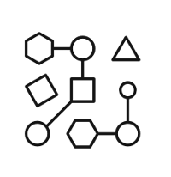

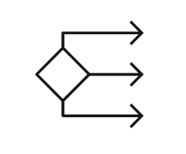


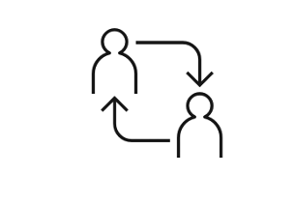
watsonx.ai – generative AI with traditional AI features
Train, validate, tune, and deploy AI models with confidence
Generative AI capabilities
Plus, a proven studio for machine learning
Foundation model library
ModelOps
Prompt lab
Automated development
Tuning studio
Decision optimization
Team collaboration and data preparation
Notes:
Watsonx.ai is part of the IBM watsonx platform that provides foundation models (FMs) and generative AI capabilities, plus traditional AI and machine learning modelling that clients have come to know (in IBM Watson Studio and IBM Watson Machine Learning).
The generative AI capabilities in watsonx.ai include the following:
Foundation model library – Includes many well-known models such as Generative Pre-trained transformer (GPT), Fine-tuned Language Net (FLAN), and more, as well as IBM’s own foundation models. Many of the models have been rebuilt on IBM’s data sets to reduce model sizes, mitigate problems (such as bias) and other common risks.
Prompt lab – Prompt engineering is a way of helping FMs become more accurate and precise in their response by providing some user interaction (called prompts). Prompt engineering is an “art” and requires practice. IBM provides samples of prompts and prompt templates, and the studio helps users to try different prompts and different models to get the best results.
Tuning studio – there are multiple ways that watsonx.ai lets clients fine-tune FMs:
Providing additional data to further train the model
Changing various runtime parameters such as
Number of virtual tokens
Batch size
Gradient accumulation steps
Learning rate
Max input/output tokens
Number of epochs
These parameters can alter the amount of time (resource) required to train the model when prompt tuning.
Plus a proven studio for machine learning (ML)
Clients continue to have access to familiar features from IBM Watson Studio in watsonx.ai such as
Model operations: training, deploying, managing, and more
Automated development
Decision optimization
In addition, team collaboration and data preparation is available for all models.

Slide 18
watsonx.ai is based on foundation models that are multi-model on multi-cloud with no lock-in
Use IBM models
Use IBM + open + other models
Try
Tune
Build and Evaluate
Deploy*
*on any cloud
Bring your own models
BYO Model
Notes:
IBM’s AI solution includes both traditional AI (IBM Watson Studio and IBM Watson Machine Learning) as well as generative AI. The focus here is on generative AI.
Some important notes for clients to consider:
One model will not rule them all. Instead of one model to address all use cases and performance needs, clients will benefit from many models — IBM models, open-source models, and as clients participate in the creation process, they may have their own models. The global open AI community is incredibly vibrant and creative. It offers a wide diversity of innovations and models at an accelerated pace; and through IBM’s partnership with Hugging Face, IBM is incorporating the best open-source models, datasets, and libraries into the watsonx.ai platform to increase the value of foundation models (FMs)to clients’ businesses.
Because one size does not necessarily fit all, IBM is building “families” of FMs of different sizes and architectures and providing multiple tuning methods from which to choose. IBM’s model architectures bring together cutting-edge innovations from IBM Research and the open research community to deliver performance, speed, and efficiency — architectures optimized for generative tasks, or for fine-tuning on specific tasks, for high inference efficiency and performance, or speed and effectiveness for enterprise natural language processing (NLP) tasks. Furthermore, they can be customized for a range of enterprise tasks in customer care, digital labor, IT operations, and cybersecurity. See backup slide on “Leveraging foundation model capabilities across various domains” for examples.
One important IBM strategy for clients is to help infuse AI into their business processes. It is important to have application programming interfaces (APIs) and other tooling like Python notebooks to help clients exploit generative AI.
With watsonx.ai:
Clients can leverage available foundation models – these include IBM proprietary models as well as various open-source models from GPT to Hugging Face models. Clients can also build their own generative AI applications with watsonx.ai.
Clients can examine their prompt history – prompt engineering is an art and sometimes the more one tweaks, the less effective it may become. The prompt history allows clients to easily go back to previous prompts to find the optimal.
Clients have access to APIs and Python libraries, starter notebooks, and a software development kit (SDK) to provide easy and simple entry points for new generative AI users, and for data scientists to quickly determine how to exploit foundation models and generative AI. This enables businesses to deploy and incorporate generative AI capabilities into business processes.

Slide 19
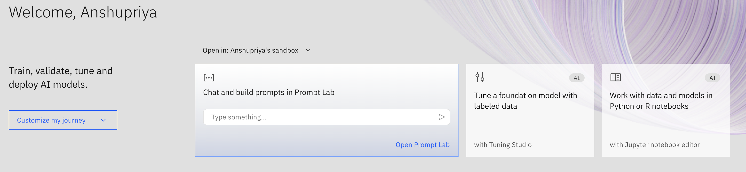
watsonx.ai Build, train, validate, tune, and deploy AI models
A next generation enterprise studio for AI builders to train, validate, tune, and deploy generative AI, foundation models, and machine learning capabilities. The watsonx.ai components include:
Foundation Model Library with IBM and open-source models
Prompt Lab to experiment with foundation models and build prompts for various use cases and tasks
Tuning Studio to tune your foundation models with labeled data
Data Science and MLOps to build machine learning models automatically with model training, development, visual modeling, and synthetic data generation
Notes:
IBM watsonx.ai. is an enterprise studio to train, validate, tune, and deploy traditional machine learning (ML) and foundation models (FMs) that provide generative AI capabilities. IBM watsonx.ai components include a Foundation Model Library, a Prompt Lab, a Tuning Studio, and Data Science and Machine Learning Operations (MLOps) capabilities. Specifically:
Foundation Model Library - Clients have access to a family of IBM models of different sizes and architectures, IBM selected open-source models from the Hugging Face community, and other third-party models including Llama and StarCoder large language model (LLM) for code generation.
Prompt Lab - AI builders can work with FMs through prompts and experiment with zero-shot, one-shot, or few-shot prompting to support a range of natural language processing (NLP) type tasks including question answering, content generation, summarization, text classification, and extraction. This lab helps beginners to experts build, manage, and benchmark their prompts.
Tuning Studio - FMs can be further customized for better performance. Tuning can be useful to adapt existing models to domain-specific tasks (for example, learn new tasks or be very domain specific). Tuning also allows businesses to harness their proprietary data to differentiate their applications with focused, business data.
Data Science and MLOps - IBM provides all the tools, pipelines and runtimes powered by FMs a business needs to support building ML models automatically. Clients can automate their entire AI model lifecycle from development to deployment with connections to a variety of application programming interfaces (APIs), software development kits (SDKs), and libraries. You can even address any data gaps with by creating synthetic tabular data.

Slide 20
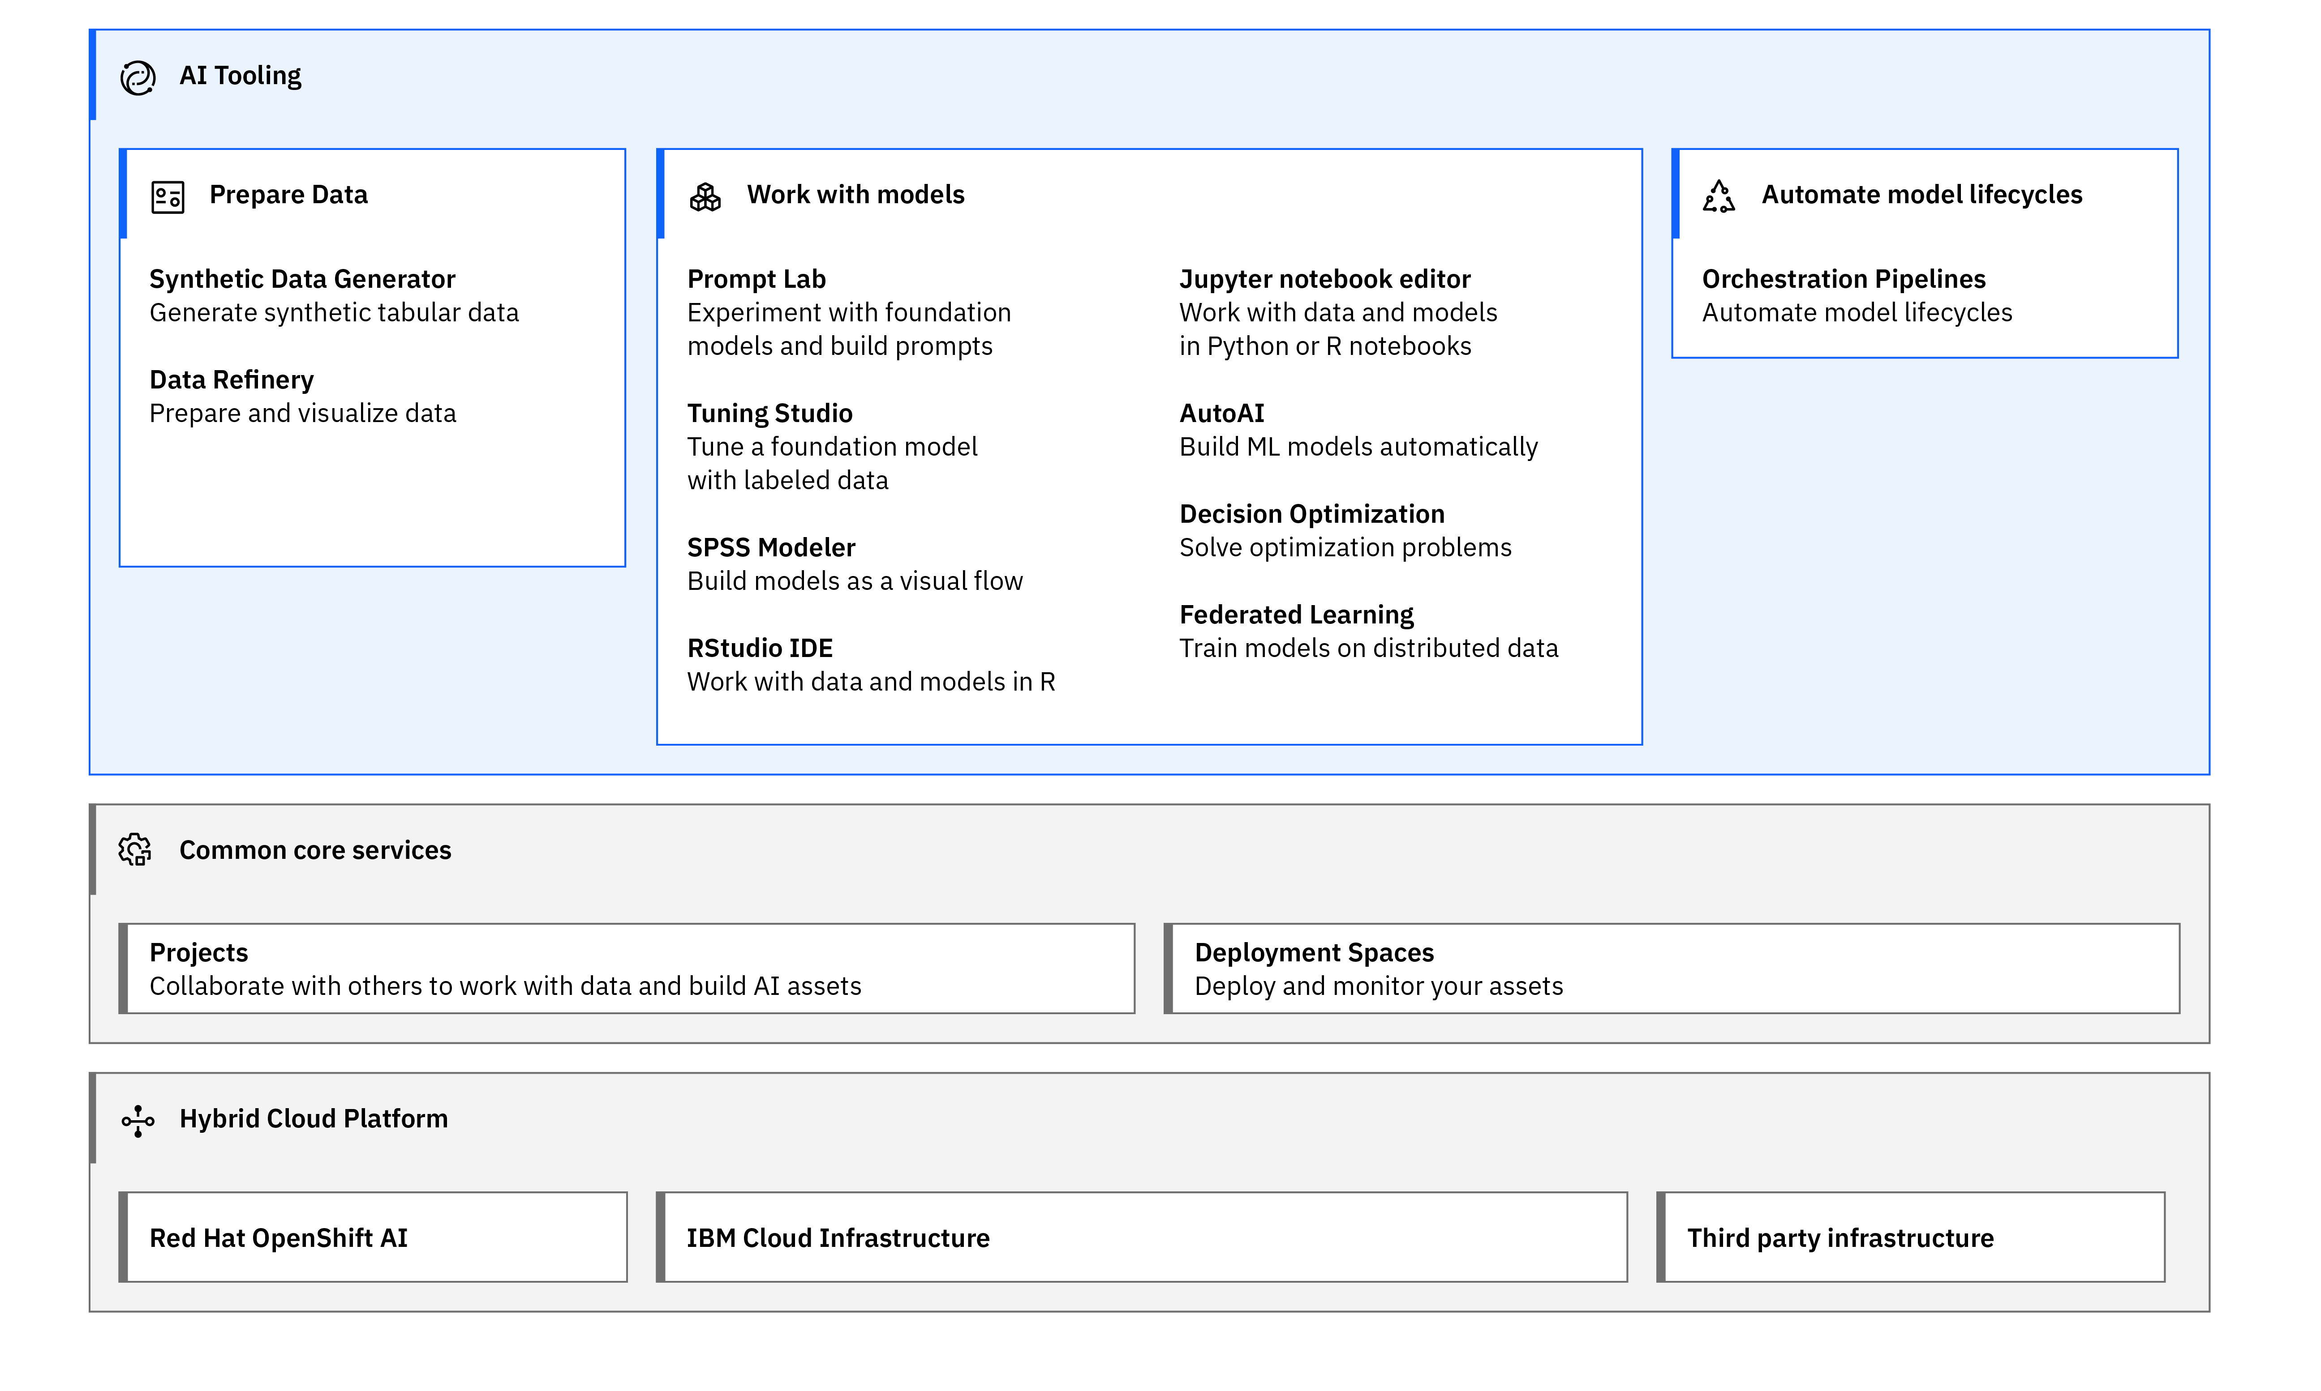
IBM watsonx.ai architecture
Common core services
Collaborative projects
Deployment spaces
Jobs
Notifications
Common connectivity
Access and Authentication
Resource management
Central asset management system
Notes:
This slide is self-explanatory.

Slide 21





watsonx.ai Foundation Model Library
Model variety to cover enterprise use cases and compliance requirements
IBM models
Opensource models
Experiment with open source models
IBM and Hugging Face partnership demonstrates our shared commitment to delivering to clients an open ecosystem approach that allows them to define the best models for their business needs.
IBM’s suite of foundation models is designed to ensure model trust and efficiency in business applications. Our suite of models features:
Transparent Pre-Training on IBM’s trusted Data Lake
One of the largest repositories of enterprise-relevant training data
Verified legal and safety reviews by IBM
Full, auditable data lineage available for any IBM Model
Compute-Optimal Model Training and Architectures
Granite Decoder only transformers
Slate Encoder only transformers
Sandstone Encoder-decoder transformers
Efficient Domain and Task Specialization
Models Coming Soon:
Finance
Cybersecurity
Legal, etc.
Bring-your-own-model
Optional add-on for more flexibility
Partner with IBM Research to pre-train your own foundation models.
Notes:
IBM watsonx.ai provides the best of both worlds.
IBM models
Foundation models like ChatGPT are “black” (opaque) boxes and that is one big reason why trust is difficult to achieve with these kind of models. IBM’s models are designed to address this gap to ensure model trust and efficiency in business applications. In particular, IBM’s suite of models features:
Transparent pre-training on trusted data One of the most important trust factors for models is the data that is used to train the model. There are 2 main issues: the quality of the data and the relevance of the data. Having random data from an internet crawl will likely inject bias, hate, and prejudice into the model. Whereas just using any data can bloat the model with parameters that may never be used. IBM has collected the largest known repository for enterprise-relevant training data covering a variety of topics like legal, finance, human resources (HR), and more. This data was then further cleansed and curated (remove duplicates, filter out bias, copyrights, etc.) to create a base pool of data used to build IBM’s model. IBM models have fully auditable data lineage and transparency – allowing clients to use them out of the box with trust.
Compute-optimal model training and architecture Using the trusted data, IBM is building different models that can be applied in different scenarios, some of which include:
Granite series models – are decoder-only transformers and are great for generative tasks such as generating emails and marketing materials.
Slate series models – are encoder-only transformers – smaller and compact but are better for non-generative use cases such as extracting and summarization and may require task-specific labeled data to fine-tune.
Sandstone series models – are encoder-decoder transformers supporting both generative and non-generative use cases. These have the best cost performance trade-off for generative use cases when the input is large but generated output is small.
Efficient domain and task specialization IBM provides domain-specific models where they are pre-trained with specific relevant data. This allows the model size to be minimized with focused pre-training for specific domain use cases such as finance, cybersecurity, legal, etc.
Open-source model IBM has a partnership with Hugging Face to provide access to open-source models to clients. IBM will work jointly with Hugging Face and surface the best models suited to clients’ business needs.

Slide 22
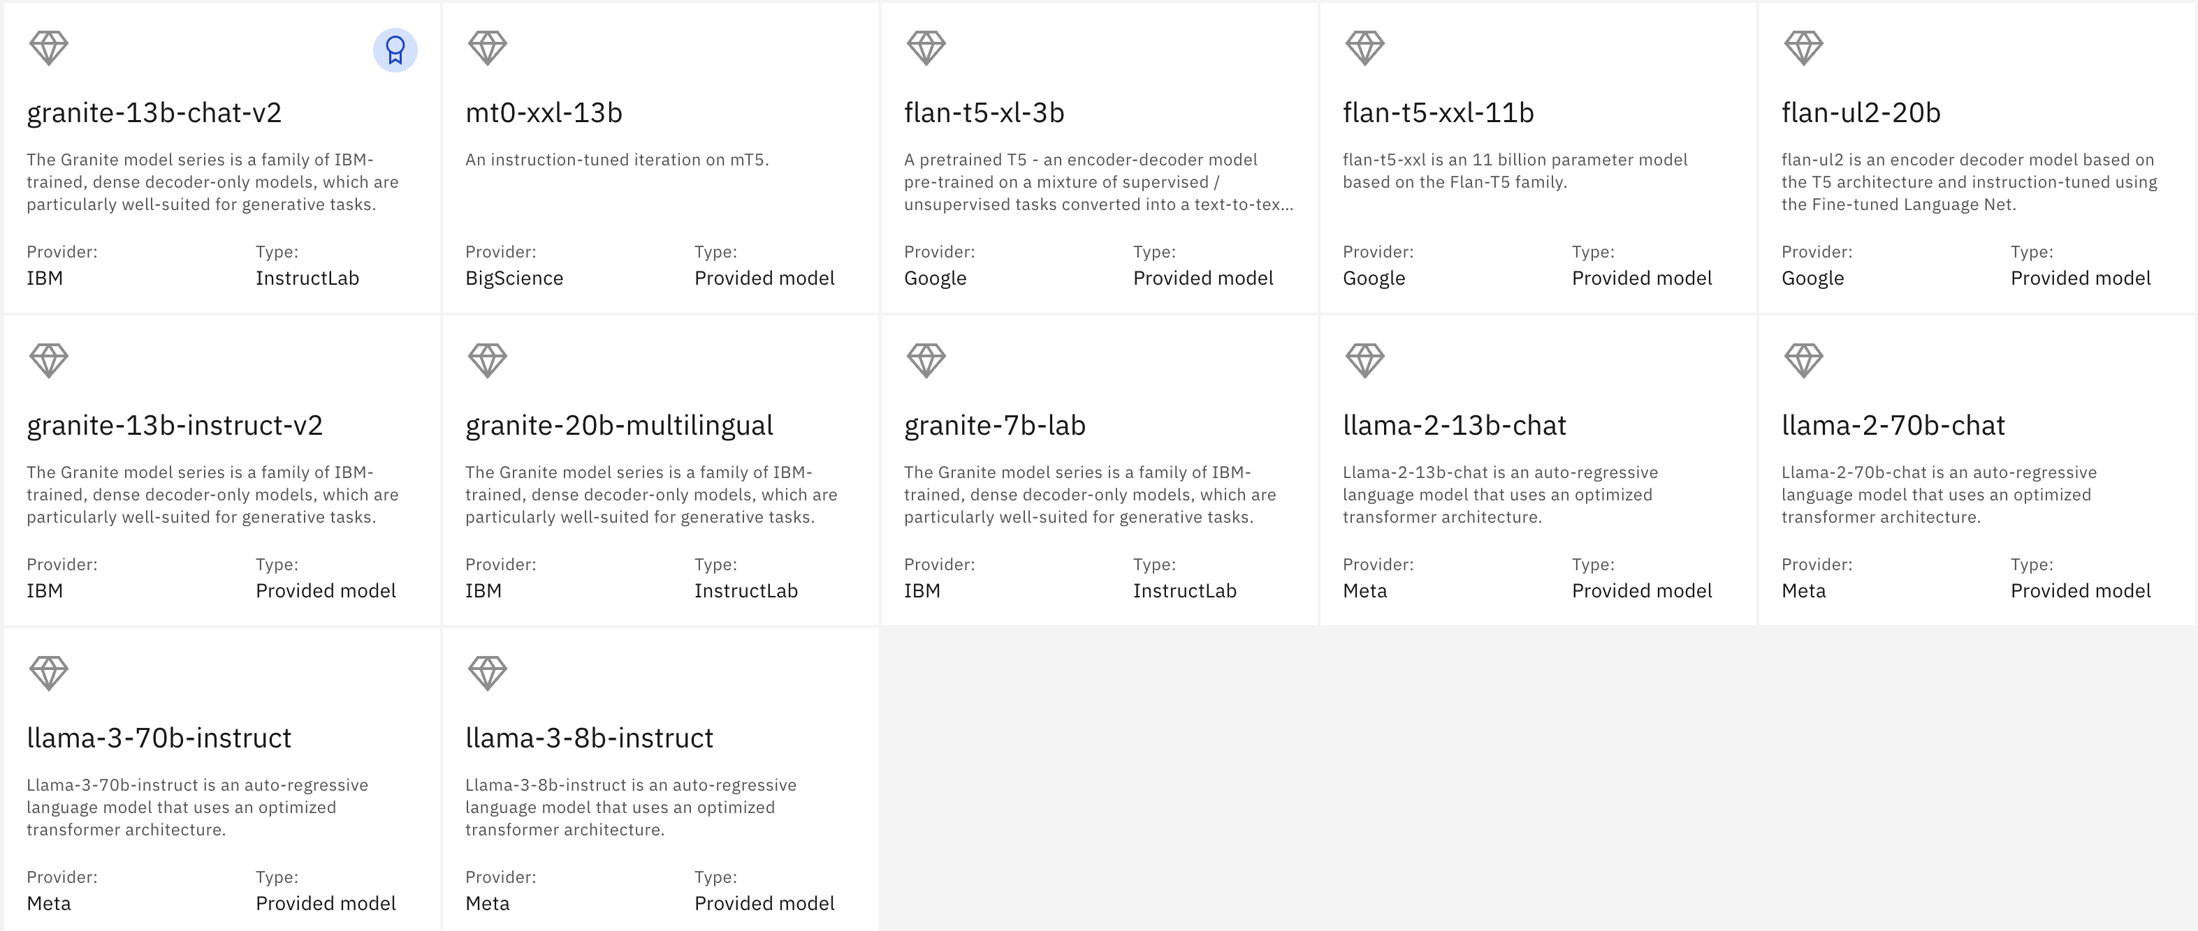
watsonx.ai – Foundation Models available
Notes:
This slide has a list off all foundation models available as of today.

Slide 23
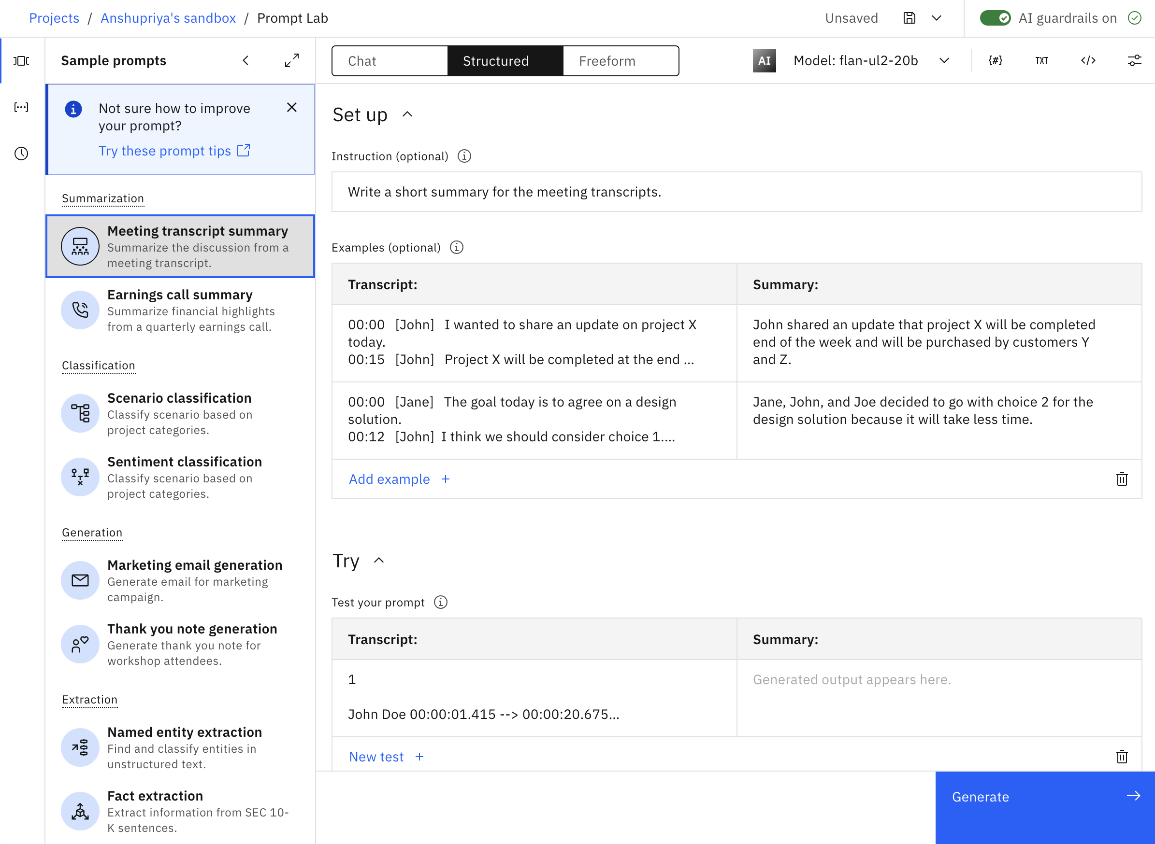
watsonx.ai: Prompt Lab
Experiment with foundation models and build prompts
Interactive prompt builder
Experiment with prompt engineering
Includes prompt examples for various use cases and tasks
Experiment with different prompts, save and reuse older prompts, use different models and vary different parameters
Experiment with zero-shot, one-shot, or few-shot prompting to get the best results
Choice of foundation models to use based on task requirements
Prevent the model from generating repeating phrases
Number of min. and max. new tokens in the response
Stop sequences – specifies sequences whose appearances should stop the model
Notes:
This self-explanatory slide describes the features available from the watsonx.ai prompt lab. Clients can work with the Prompt Lab in many ways.
A prompt is a way for clients to interact and instruct foundation models to provide answers. In generative AI, the model is not “answering” but is “generating” a response based on input and what it has been trained on. How one “prompts” the model can bring very different results. Prompt engineering is the “art” of prompting in ways that a model can best understand and respond to client requests.
The Prompt Lab is a part of the watsonx.ai user interface (UI) that allows users to perform prompt engineering, and experiment with different prompts across different foundation models.
Experienced clients can select the model of interest and experiment with different prompts to see what works best for a particular model. Clients can try different “shots” with prompts:
Zero-shot prompting – simply passing a request into the model without additional information. Some models (larger ones) will respond better than others, depending on the request.
Clients can learn to provide simple input to orient the model properly to the user’s intention to provide the best answer.
Less experienced users can select different prompt samples from the Prompt Lab and learn how the examples utilize one-shot or few-shot tuning.
One-shot prompting - One-shot prompting involves giving an AI a single example to guide its response
Few-shot prompting - Few-shot prompting provides a few examples, helping the AI understand the context or task better.
Clients can set various parameters such as:
Greedy vs Sampling – with ”Greedy” the word/token with the highest probability is selected. Most large language models (LLMs) operate this way, it is the simplest form of next-word prediction. In sampling, the model selects a token using a random-weighted strategy across the probabilities of all tokens, resulting in the possibility of returning a less probable answer. This is used for creativity and to avoid repeating words but can cause the LLM to “wander” into other areas.
Sampling parameters include:
Temperature – in general, the higher the temperature the higher the randomness. Setting the temperature to 0 means the model will always return exactly the same result (it will be deterministic). A higher temperature allows the model to consider other probabilities (non-deterministic) and cause hallucinations.
Top P – use this to limit random sampling to predictions whose combined probabilities do not exceed the threshold (value of P). A Top P value of 1 means everything is considered. A lower Top P value weeds out the lower probability options.
Top K – let the model select from the top K results only.
Repetition penalty – to prevent the model from generating repeating phrases
Stop sequences - tell the model to stop generating any more output once it encounters the specified stop sequence.
Min./max. new tokens – the minimum or maximum new tokens used in the response – controlling how “verbose” the response should be.
Note that, unlike traditional AI tasks, generative AI creates a response best suited to its understanding of the question. This requires experience on the user’s part to learn how to effectively prompt the model as it needs to understand enough of the intent of the request. Using the prompt lab develops this experience.
The best way to learn how to pass good prompts is by example. The watsonx.ai prompt lab provides many examples of various natural language processing (NLP) tasks such as:
Summarization
Extraction
Generation
Classification
And more …
IBM watsonx.ai prompt lab keeps a history of prompts. As part of learning, users may want to go back to previous prompts what might have worked better or to tweak them differently. The user interface keeps track of past prompts and users can easily move back and forth.
Once a data scientist/engineer has found the best prompt, it can be passed in via an application programming interface (API) or Python notebook to the model. It can be used to automate tasks for other users.
While clients can prompt tune or fine-tune their models, that requires work and resources. Prompt engineering is a way to evolve a model for the needs of the clients without model rebuilding or a lot of labeled data.

Slide 24
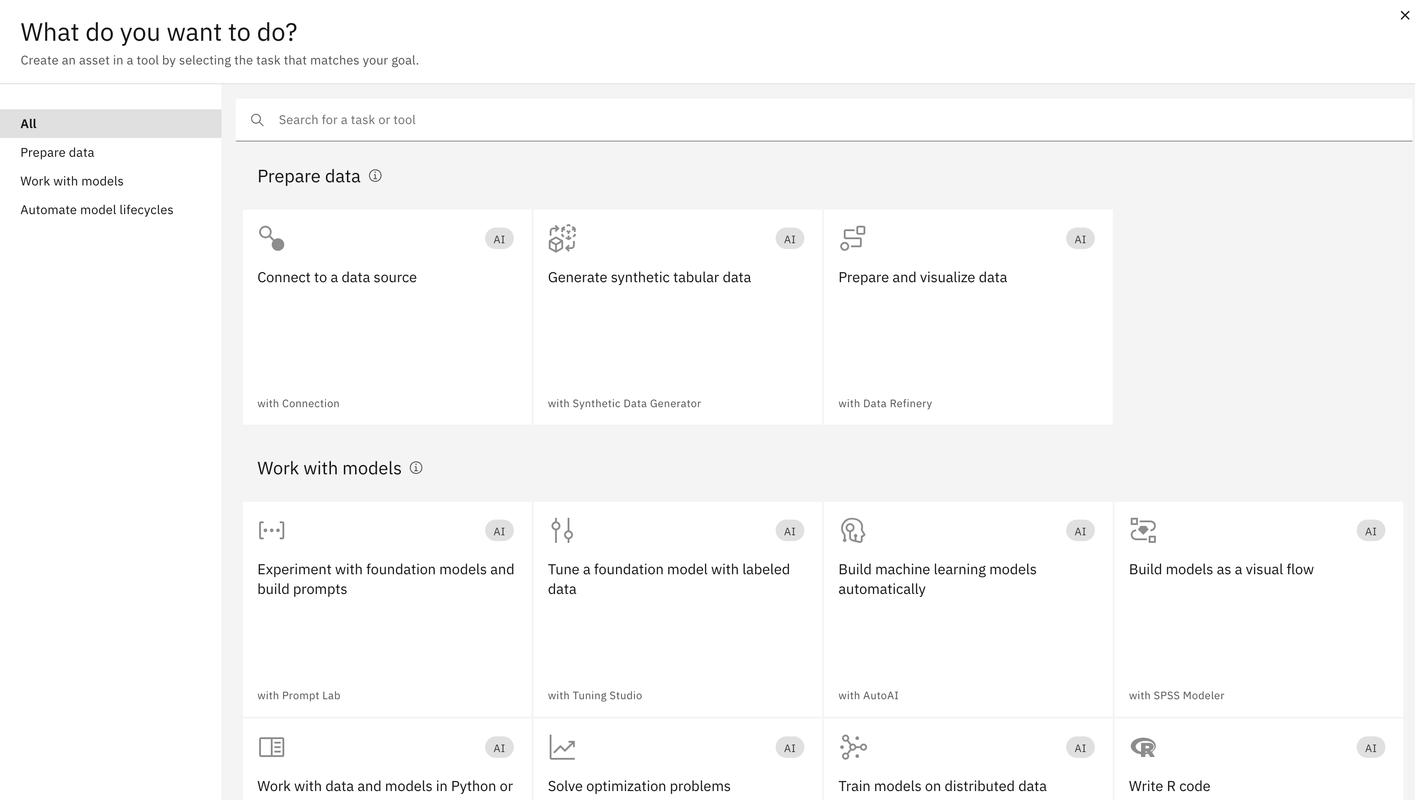
watsonx.ai: Data Science and MLOps Build machine learning models automatically in the studio
Model training and development
Integrated visual modeling
Build experiments quickly and enhance training by optimizing pipelines and identifying the right combination of data
AutoAI, including preparing data for machine learning and generating and ranking candidate model pipelines
Use predictions to optimize decisions, create and edit models in Python, in OPL or with natural language
Prepare data quickly and develop models visually to help visualize and analyze enterprise data to identify patterns and trends, explore opportunities, and make informed, insightful business decisions
Uncover correlations
Insight for hypotheses
Find relationships and connections within the data
Notes:
This slide shows the AI operations available from watsonx.ai. This provides clients with familiar AI model build and operation available to apply machine learning operations (MLOps) against foundation models.
Watsonx.ai
Model training and development
Clients can experiment with building with foundation models, and organize pipelines when tuning is necessary.
AutoAI – providing process automation – generating and ranking models candidate
Provide predictions for decision optimization. Clients can work with models in Python, natural language, or OPL stack (OpenAI, Pinecone, and Langchain).
Integrated visual modeling
Visual modeling is an easy way to develop models and to analyze data by looking for patterns, and trends. This helps businesses to make the right decisions. Generative AI can help to extract/summarize information for comparison and provide natural language processing (NLP) to make the process even more end-user friendly.
Navigation
To get to the panel on the slide:
On the main console of watsonx.ai, click on the appropriate project (typically named “<<user_name>> sandbox”)
On the subsequent window, click on the blue “New task” button on the upper right

Slide 25
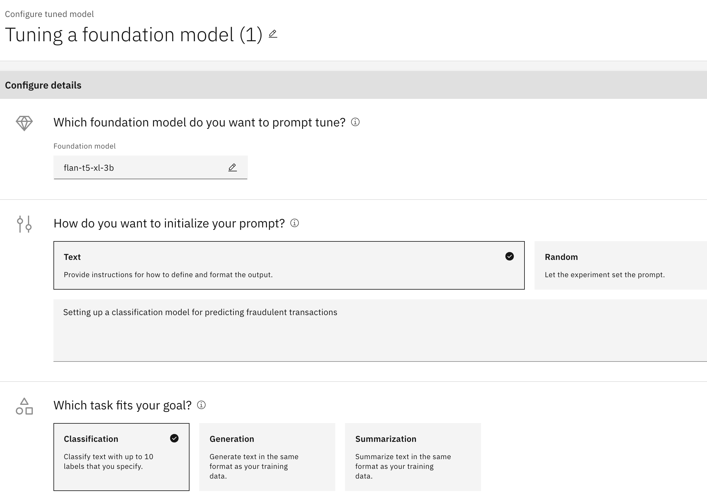
watsonx.ai: Tuning Studio Tune your foundation models with labeled data
Prompt tuning
Task support in the Tuning Studio
Efficient, low-cost way of adapting an AI foundation model to new downstream tasks
Tune the prompts with no changes to the underlying base model or weights
Unlike prompt engineering, prompt tuning allows clients to further enhance the model with focused, business data
Models support a range of Language Tasks: Q&A, Generate, Extract, Summarize, Classify
Requires a small set of labelled data to perform specialized tasks
Can achieve close to fine-tuning results without model modification, at a lower cost to run
Notes:
The Tuning Studio allows clients to try out prompt-tuning and fine-tuning.
With prompt tuning, clients can choose a model and use their own specific data to enhance that model. While foundation models are very capable at a general level, businesses have their business terminologies, specific workflow, and specific output that they expect from queries. In prompt-tuning, clients can feed a set of <input query>-<expected output> pairs into the model. This teaches the model to better understand the intent of specific questions and how to generate the most relevant output.
As clients pass data into their model, there are also parameters they can modify to enhance the model. Keep in mind that this (depending on the model) can be a very involved and resource expensive process. Clients can consider using larger batch_size (number of samples to work through before modifying any internal parameters) and smaller num_epochs (number of times to cycle through the sample data) to control training time/cost.
There are two important things to note with prompt tuning:
No model weights are changed with the process. Clients are enhancing the model, but the original parameter weights can be kept intact.
With the proper set of data, this can achieve near-fine-tuning results. This is important – while fine-tuning a model may give the best results, it is much more expensive as the model is updated (the bigger the model is originally, the more expensive it is). Prompt tuning also avoids catastrophic forgetting (for example, the underlying model has so much of the weights modified it no longer resembles the original – this essentially destroys the reason why the base model was chosen in the first place).

Slide 26
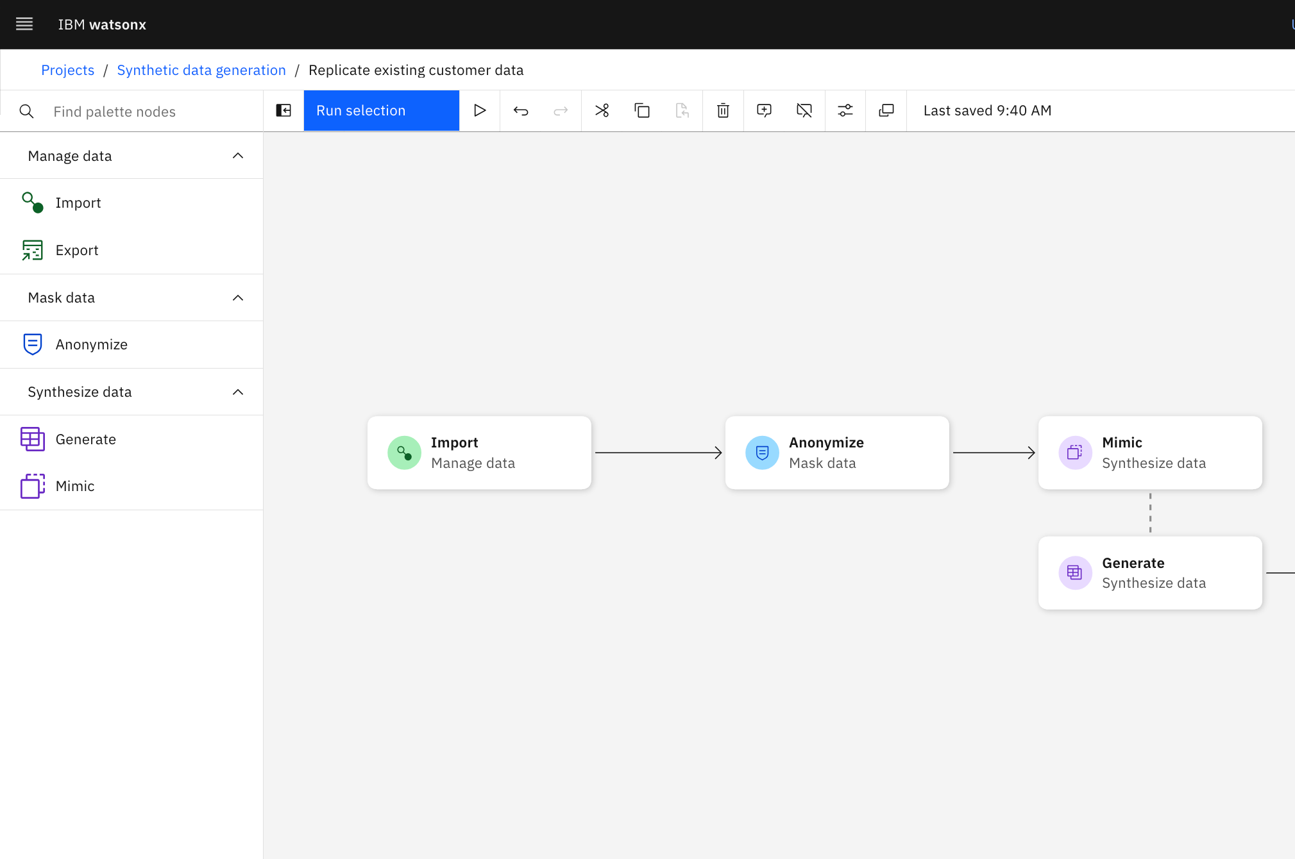
watsonx.ai: Synthetic Data Generator Generate synthetic tabular data to address your data gaps
Create synthetic data at scale
Select your model & privacy needs
Unlock your valuable insights by using synthetic data.
Create synthetic data using your existing data in a database or by uploading a file. If no data exists or can’t be accessed, you can design your own data schema.
Address data gaps and create synthetic edge cases to expedite classical AI model training.
Depending on your cost, fidelity, application, or data needs, you can select from multiple IBM models* to create your synthetic tabular data.
When using existing data, IBM models apply differential privacy to minimize your privacy risk and give you control over the level of privacy protection required for your organization.
Notes:
There is tremendous value in the data that businesses collect, but access and availability to that sensitive data remain ongoing obstacles that impact speed-to-market, privacy risk, and overall ability to innovate. This influences what insights you can collect, how much data you can share, how much you spend on data, how many AI models you can deploy, how quickly you can do so, and how effective they are.
IBM watsonx.ai’s Synthetic Data Generator helps tackle this problem by enabling businesses to generate the synthetic tabular data they need, using existing data from a database or file or using a custom data schema. When using existing data, clients can use masking capabilities to remove/hide particular table columns prior to generating synthetic data, as well as the option to apply differential privacy to ensure minimal privacy risk.
Three IBM synthetic data generation models will be available: statistics-based, agent-based, and generative AI-based.
IBM model overview:
Statistics-based model – This model can generate synthetic data based on existing data or a custom data schema. Although not as accurate as a generative-AI model, it provides the quickest, most affordable way to approximate your real data since it leverages CPU vs GPU. This model is best suited for creating edge case data, additional data for AI model training, demo data, or data for internal training. Differential privacy will be available for this model in Q4 to ensure minimal privacy exposure.
Agent-based model – This model can ingest real data and new data schemas. This model is best suited for use cases where no existing data exists or is accessible, specifically better understanding “what-if” scenarios through agent-based simulations. This model leverages a combination of statistical models and business rules to create synthetic agents, which can represent cars, financial transactions, customers, products, patients, etc. This is a mature/advanced approach to data synthesis best suited for enterprises already familiar with and deploying synthetic data that are interested in adding another “tool” to their synthetic “toolbox”.
Generative AI model – This model can only ingest existing data. It is best suited for use cases that require high fidelity and differential privacy to mitigate privacy risk, such as internally extracting insights, sharing externally as a method to monetize, or generating more data to train classical AI models. This model leverages GPUs, so takes longer and is more expensive, but provides higher accuracy relative to statistical model and requires less domain expertise (thus, more line-of-business friendly).

Slide 27

watsonx Flows Engine A developer-centric solution for building enterprise-grade AI applications.
Build
Deploy
Observe
AI
powerful applications that integrate with your data and tools.
your
AI application easily and embed into your enterprise systems.
and
optimize performance over time.
Notes:
The IBM Watsonx Flows Engine is a tool designed to simplify the creation of generative AI applications, specifically for enterprise use. It allows developers to integrate Large Language Models (LLMs) with business data, creating workflows that handle tasks such as Retrieval Augmented Generation (RAG) and Summarization. Developers of all levels can use the intuitive flow language to customize and deploy applications quickly, using pre-built flows or creating new ones tailored to their needs.
With watsonx flows engine developers can:
Build: Customizable AI Flows to enable powerful AI applications that can integrate with their data and pre-existing tools
Deploy: Seamlessly integrate the application into enterprise systems, which can be consumed via HTTPs, Python, or JavaScript.
Observe: Utilize the built-in monitoring and debugging tools to observe and optimize performance over time.

Slide 28
watsonx Flows Engine features A graph-based declarative approach that simplifies development of AI applications
Simplified integration of generative AI with enterprise data through pre-built AI flows.
Rapid development and deployment of AI applications for developers of all skill levels.
Enhanced business solutions with features like retrieval augmented generation and summarization.
Built-in evaluation, debugging, and monitoring tools for easy scaling and maintenance.
Accelerated time-to-value for AI solutions while reducing the complexity of building applications.
Notes:
Some of the features of the watsonx Flows Engine:
Simplified Integration with Enterprise Data: Pre-built AI flows, such as Retrieval Augmented Generation (RAG) and Summarization, make it easier to connect AI models with existing enterprise systems and data, streamlining complex integrations.
Rapid AI Development: Developers of all skill levels can quickly build, customize, and deploy AI applications, reducing the need for extensive expertise in machine learning or coding.
Enhanced Business Solutions: AI flows can optimize business tasks like data retrieval and summarization, making AI-driven decisions more efficient.
Built-in Tools for Maintenance: The platform includes evaluation, debugging, and monitoring capabilities, allowing teams to identify and resolve issues faster while keeping track of performance and model accuracy.
Faster Time-to-Value: The platform accelerates the deployment of AI applications, allowing businesses to realize the benefits of their AI solutions sooner while minimizing the complexity of the development process.

Slide 29
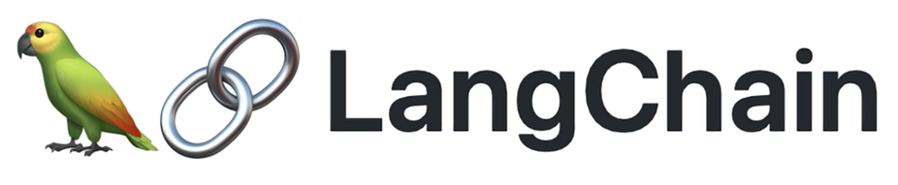



watsonx Flows Engine integration One entry point to get the best of IBM and the open-source
Deep integration into the IBM ecosystem
Extensions into the open-source (coming soon)
watsonx
IBM & third-party models
Inference endpoints
Guardrails
watsonx.data
Migrate your existing apps to Flows Engine
Embed Flows Engine in other frameworks
Milvus vectordb
Elasticsearch
PostgreSQL
Other integrations coming soon!
Flows Engine
Notes:
Watsonx Flows Engine offers integration within the IBM ecosystem and open-source tools:
IBM Ecosystem Integration: Supports integration into IBM and third-party models, inference endpoints, and guardrails and with watsonx.data utilizing vector databases like Milvus vectordb. Other integrations are a part of the future roadmap.
Open-Source Extensions: Future updates will allow integrations with popular AI frameworks like LangChain, LlamaIndex, and Hugging Face. This allows clients to migrate existing apps to Flows Engine and embed it into other frameworks, ensuring flexibility and extensibility.

Slide 30
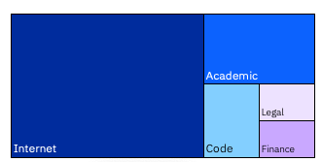
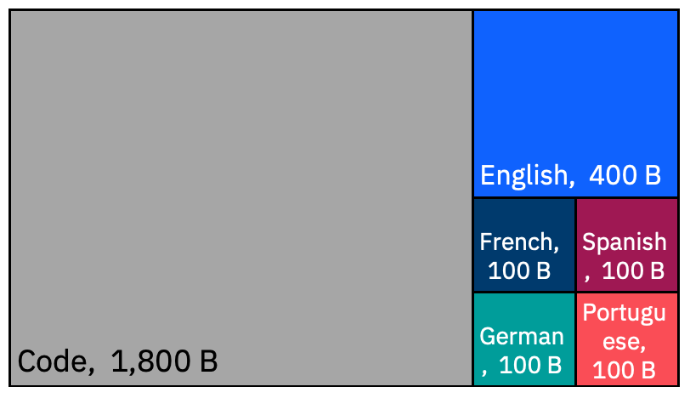
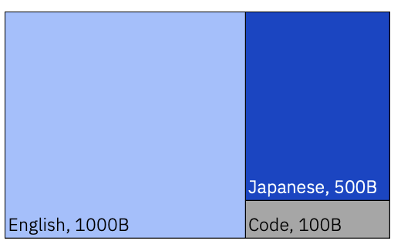
AI for business - IBM Granite
Granite is IBM's flagship series of LLM foundation models based on decoder-only transformer architecture.
Granite language models are trained on trusted enterprise data spanning internet, academic, code, legal and finance.
granite-13b-v2 ( English LLM ) -chat-v2.1, -instruct-v2
granite-20b-multilingual
granite-8b-japanese
13B parameters in size 2.5T tokens of data
20B parameters in size 2.6 T tokens of Data
8B parameters in size 1.6T tokens of Data
Notes:
Introduction to Granite Models
Granite models are advanced AI models developed by IBM Research. They utilize generative AI to excel in specialized business-domain tasks such as summarization, question-answering, and classification. They are built on a "decoder" architecture which is designed to predict the next word in a sequence without requiring knowledge of the entire sentence. This architecture is considered uni-directional, enhancing efficiency in natural language understanding tasks. The granite model comes in different forms and sizes, recognizing that a single model will not fit the unique needs of every business use case.
With these models and watsonx, IBM enables businesses to be AI value creators. Businesses can bring their proprietary data to IBM base models and build a model that is unique to their business and use cases.
Datasets the Granite model has been trained on
Granite models have been trained on diverse business-relevant datasets from five domains: Internet, Academic, Code, Legal, and Finance specifically:
Internet — Generic unstructured language data taken from the public internet
Academic — Technical unstructured language data, focussed on science and technology
Code — Unstructured code data sets covering a variety of coding languages
Legal — Enterprise-relevant unstructured language data taken from legal opinions and other public findings
Finance — Enterprise-relevant unstructured data taken from publicly posted financial documents and reports
The Granite model has three variants:
granite-13b-v2 ( English LLM ): This model has 13 billion parameters and is trained on 2.5T tokens of data.
-chat-v2.1: Chat derivative model is optimized for dialogue use cases and works well with virtual agent and chat applications.​
-instruct-v2: Instruct derivative model was designed to perform well on natural language tasks and can be customized for specific industries and domains via prompt-tuning.
granite-20b-multilingual: This model has 20 billion parameters and is trained on 2.6T tokens of data. This model provides support for English, French, Spanish, German and Portugese.
granite-8b-Japanese: This model has 8 billion parameters and is trained on 1.6T tokens of data. This model supports Japanese. Note – this model is only available in the Tokyo data centers.

Slide 31
watsonx.ai value proposition
Improved
performance
Developing specialized models to produce better results for targeted tasks with lower infrastructure requirements to achieve improved price-performance, (granite.13b for financial tasks).
Enhancement of models delivered through model refresh (granite.13b.V2), new models developed by IBM (e.g., granite.20b multilingual), or 3rd
party models
3x Price-cuts
granite.13b [3X less cost] available today at $0.0006 1,000 tokens (input/output)
llama2.70b [2.7X less cost] available today at $0.0018 1,000 tokens (input/output)
Llama2 13b [3X less cost] available today at $0.0006 1,000 tokens (input/output)
Multi-lingual support
Expanding language support beyond English through a combination of 3rd party model providers and IBM-developed multi-lingual models that support:
English
Japanese
Spanish
Portuguese
French
German
Differentiated Client Protection
IBM stands behind IBM-developed models and indemnifies the client against third-party IP claims.
IBM offers an additional peace of mind to clients by:
not requiring them to indemnify IBM for their
use of its models
not capping its IP indemnification liability
Notes:
IBM watsonx.ai value proposition:
Improving Performance. Released granite.13b.v2 as a refresh to granite.v1 that is exposed to 2T token vs granite.13b.v1 that was only exposed to 1T tokens. Granite.13b.V2 is priced 3X less at $0.0006/1000 tokens.
Expanding beyond English. Expanding models to other languages, starting with Japanese and 5 European languages (English, Spanish, French, German, Portuguese) coming up in Q1. Early access in December, granite.8b.japanese (Feb 29 SaaS GA, March 27 on-prem GA), granite.13b.multi-lingual (March 14 SaaS GA, March 27 on-prem).
Expanding beyond language. Establishing partnerships to bring multi-modality to the platform for visual QA. Stability.ai and Aleph Alpha Luminus model are examples.
Model IP (Intellectual Property) indemnification refers to a legal protection mechanism where the provider of a software or technology model assures the client against legal disputes arising from the use of their intellectual property (IP). IBM’s indemnification terms:
BAU for IBM-developed models, offering the same standard terms and protection that we have been offering for Hardware and Software
IBM doesn’t require customers to indemnify IBM for the use of the models (IBM is one of the very few, if not the only one)
No cap on the IP liability and the financial responsibility IBM would take
To learn more about how IBM’s standard IP indemnification methods and where it stands against its competitors check this link - https://ibm.seismic.com/Link/Content/DChT7j7jjTMCHGMMX3BDfM8qQ6b3
IBM’s guiding principles:
One model doesn’t fit all
Bigger is not always better
Specialized models can produce better results than larger, general-purpose models, and do so with lower infra requirements to achieve improved price-performance
Notes:
Link for pricing information - https://www.ibm.com/products/watsonx-ai/foundation-models

Slide 32
watsonx.ai differentiators
Open
Trusted
Targeted
Empowering
Built on open technologies
IBM’s hybrid cloud-native stack based on Red Hat OpenShift enables a flexible and secure deployment of watsonx.ai.
Hugging Face partnership provides access to the best open-source model collection.
IBM’s suite of foundation models is designed to ensure model trust and efficiency in business applications.
Models trained with scrutinized and copyright-free data
Tight integration with watsonx.governance provides clients with a trusted pathway to operationalize AI confidently and at scale.
Designed for targeted business use cases, that unlock new value.
On-prem, hybrid cloud and IBM Cloud
Designed for scalability
Right model for the right task
Industry-leading support for use case implementations.
For value creators, not just users
Tunable models at a fraction of the cost & time
Deploy anywhere
An enterprise studio that allows clients build their own differentiated AI assets with their own proprietary data, creating a competitive edge.
Notes:
This self-explanatory slide revisits an earlier slide on the key factors that drive a successful generative AI platform and shows the watsonx.ai differentiators. To recap that slide, this slide shows some more details clients should know about watsonx.ai.
Open
IBM’s watsonx.ai is a hybrid cloud-native stack built on Red Hat OpenShift. This allows watsonx to integrate easily with other IBM cloud services such as IBM Watson Studio, IBM Watson Knowledge Catalog, IBM Watson Query, etc. It also means watsonx.ai is hybrid and multicloud enabled. IBM’s partnership with Hugging Face provides clients with access to the best collection of open-source models available.
Trusted
IBM has a long history of building secure AI and data platforms. This focus is carried over to watsonx.ai to ensure IBM’s suite of foundation models is built on the principle of trust, making them ready for business applications. As a start, IBM’s models are trained on highly curated, scrutinized, and copyright-free data that was also filtered to weed out inappropriate content. The integration with watsonx.governance provides a trusted pathway to operationalize AI confidently and at scale. Watsonx.ai is an AI platform that lets clients run responsible, transparent, and explainable AI.
Targeted
Watsonx.ai is designed for targeted business use cases to unlock new value for customers. Specifically:
It can be on-premises, hybrid cloud, IBM cloud, or on the edge.
It is designed to be scalable – matching the needs of clients
Supports various models of different sizes and different architectures (encoder, decoder, and encoder-decoder) and domain-specific models (finance, cybersecurity, etc.) will be available for clients to pick the best model to use or tune for their business use cases. Industry-leading support to help clients to implement their use cases.
Empowered
Watsonx.ai is designed for AI value creators, not just users. Models can be tuned at a fraction of the cost (clients pick the right size, architecture, and domain) and they can be deployed anywhere. What’s more, the Watsonx.ai console allows clients to build, tune, and deploy their models. Clients can use their own data to create differentiated AI assets.

Slide 33
watsonx.ai is transparent, responsible, and governed
Most AI models are trained on datasets of unknown quality, representing legal, regulatory, ethical, and inaccuracy nightmares. Data provenance and quality matters. IBM ensures its AI can be trusted.
watsonx.data
Curates domain-specific and internet datasets, as well as ingesting your own
Filters for hate, profanity, biased language, and licensing restrictions before training
Tracks and manages every step of the process to meet legal and regulatory requirements
watsonx.governance
Governs training data and the AI deployed
Applies reinforcement learning with human feedback to align models with human values, reduce hallucinations, and build AI guardrails
Finds and fixes AI biases before ML AI models are tuned and deployed
IBM’s Center of Excellence for Generative AI
Over 1,000 IBM Consultants specialized in generative AI help you establish an organization to adopt and scale AI safely, detect and mitigate risks, and provide education and guidance
Notes:
Trust is an enterprise’s ultimate license to operate. The benefits of AI are moot if enterprises do not have confidence in the predictions and content generated by their models. Clients must (and they will want to) build responsibly, and transparently, and put governance into the heart of their AI lifecycle. Today, most AI models offered are trained on datasets of unknown quality and provenance. This can represent legal, regulatory, ethical, and inaccuracy nightmares. Data provenance and quality matter.
Besides bringing their own curated datasets to watsonx.data, clients will want to know that IBM is carefully curating domain-specific and internet datasets as a first step to training trustworthy models. IBM cleans those datasets and filters them for hate, profanity, biased language, licensing restrictions, and copyright information before training. And IBM continues to develop and refine new methods to improve data quality and controls. Leveraging watsonx.data capabilities, IBM tracks and manages every step of the process from data acquisition to cleansing, filtering, processing, and training that helps clients to react and meet an evolving set of legal and regulatory requirements.
In watsonx.governance, IBM tracks the curated data, the methods used to curate it, and the models that each data point has touched so if anything changes in the future, it is easier to identify affected models and any data that may need to be removed, remove it, retrain the models, and repeat the lifecycle. Simply put, watsonx.governance helps clients govern the training data clients use and the AI clients deploy so that they can operate, scale, and succeed with trust as their insurance.
IBM is developing and applying techniques in reinforcement learning from human feedback (RLHF) to align models with human values, reduce hallucinations, and build AI guardrails. Finally, for machine learning, IBM has developed methods to find and fix AI biases before AI models are tuned and deployed for enterprise tasks.
IBM’s Center of Excellence (CoE) for generative AI—with its 1000’s of consultants specialized in generative AI—is not only ready to actively build and deploy watsonx for clients, helping them implement enterprise-grade foundation models and generative AI in their operations but also helps clients operationalize AI governance. IBM’s CoE for generative AI can bring solutions and services that help clients establish the organizational structure to adopt and scale AI safely, detect and mitigate risks, and provide education and guidance while developing new solutions and assets that leverage the pipeline of innovations in watsonx. The CoE’s consultants have also developed an open, collaborative approach to quickly ideate and prioritize use cases, plan, build, implement, operate, and scale ethically responsible generative AI solutions, leveraging multiple models on multiple clouds to best meet clients’’ unique business needs.

Slide 34
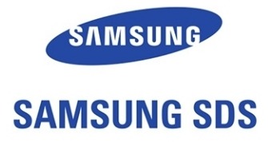



watsonx.ai is helping companies custom-build AI solutions to suit their specific needs.
Leveraged watsonx.ai foundation models to train their AI augment its support representatives’ efforts. Built a system to improve customer service and employee satisfaction using the IBM watsonx.ai™, IBM Watson® Discovery and IBM watsonx Assistant solutions
Exploring watsonx.ai generative AI capabilities for new solutions such as SDS’s Zero Touch Mobility to deliver unprecedented product innovations to improve client experience.
Using watsonx.ai to slash delivery time from 3-4 months down to 3-4 weeks for many customer care use cases.
An early adopter of generative AI, has been exploring watsonx.ai to improve content discoverability, summarization and classification of data to enhance productivity.
Notes:
This slide is self-explanatory and provides a number of client responses with the watsonx.ai early access program
Sources:
watsonx.ai Enablement - https://ibm.seismic.com/Link/Content/DCp9PcDHB6TCHGhXP3VfVBMT4FMB
Information for other clients is from the early access program.
Acronym:
SDS: Samsung Data Service

Slide 35
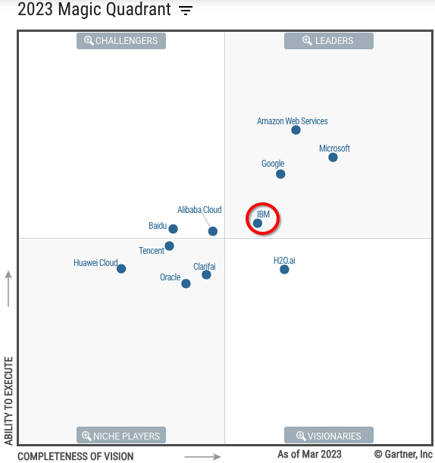
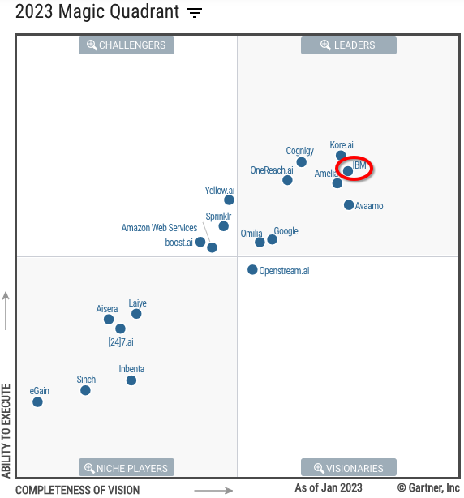
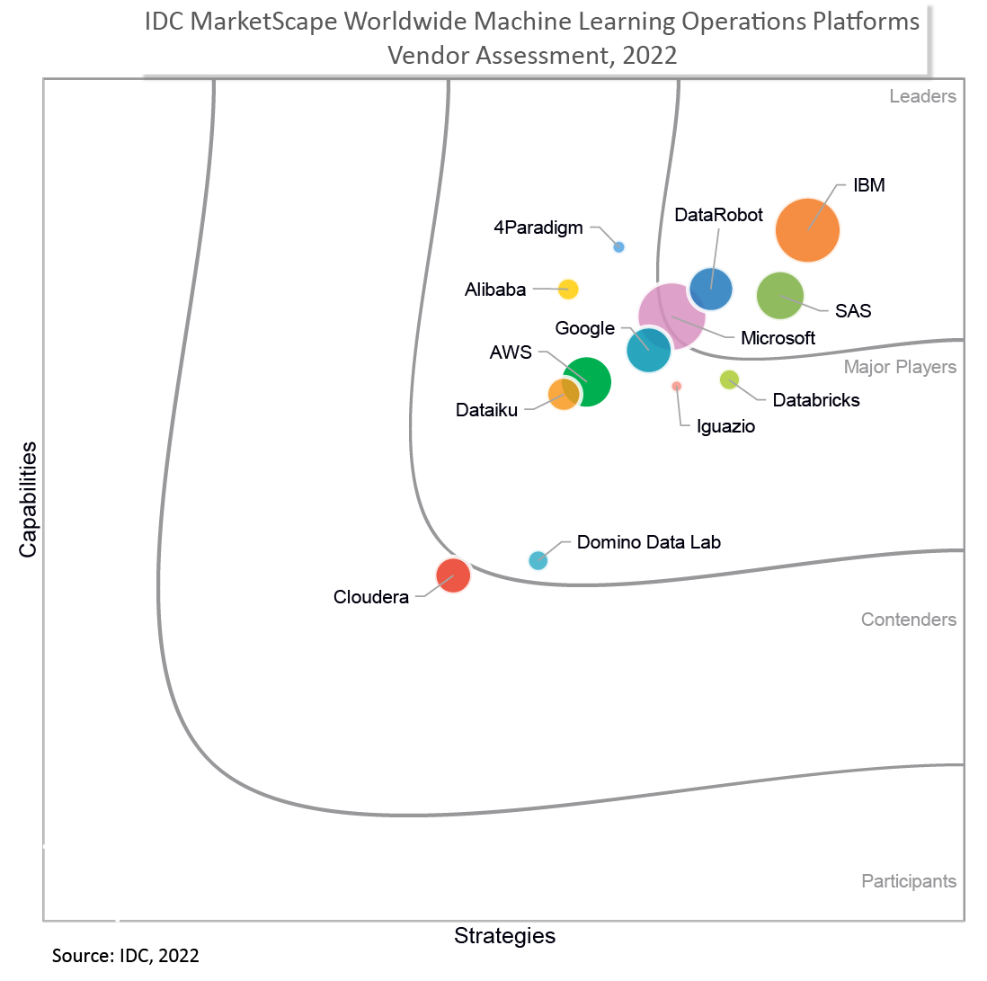
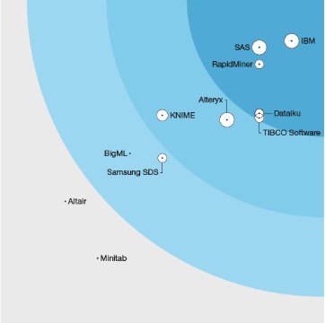
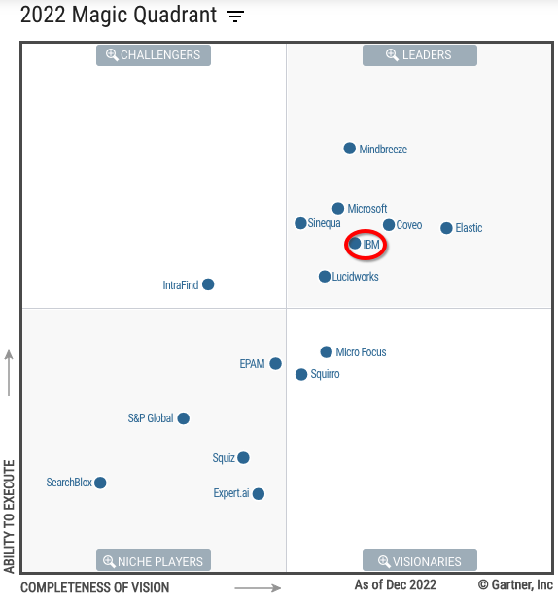
IBM is a leader in AI
MQ for Cloud
AI Developer Service
MQ for Enterprise
Conversational AI Platforms
IDC Marketscape: Leader in Worldwide Machine Learning Operations Platforms 2022 Vendor Assessment
MQ for Insight Engines
Forrester Wave:
Multimodal Predictive Analytics and Machine Learning
Multiple Gartner Magic Quadrants for AI-related capabilities
Notes:
IBM is recognized as a leader in artificial intelligence (AI) in the marketplace according to International Data Corporation (IDC), Gartner, Inc., and Forrester Research.
The Gartner Magic Quadrant (MQ) for AI includes the following:
MQ for Cloud AI Developer Services
MQ for Insight Engines
MQ for Conversational AI
Sources:
IDC Marketscape: Leader in Worldwide Machine Learning Operations Platforms 2022 Vendor Assessment: https://www.ibm.com/account/reg/us-en/signup?formid=urx-51950
Forrester Wave 2023: Data Management For Analytics: https://www.ibm.com/blog/ibm-named-a-leader-in-the-forrester-wave-data-management-for-analytics-q1-2023
Forrester TEI for IBM Data Management: https://www.ibm.com/downloads/cas/9X4AX5WK
Gartner MQ for Cloud AI Developer Services: https://www.gartner.com/document/4372099?ref=solrAll&refval=378158450&
Gartner MQ for Conversational AI: https://www.gartner.com/document/4154599?ref=solrAll&refval=367313557
Gartner MQ for Insight Engines: https://www.gartner.com/document/4022148?ref=solrAll&refval=367313691

Slide 36
How to get started with watsonx.ai today IBM’s investment in partnering with you
FREE TRIAL
Experience watsonx.ai yourself with a free trial through ibm.com/watsonx.
Try our free trial
CLIENT BRIEFING
Discussion and custom demonstration of IBM’s generative AI watsonx point-of-view and capabilities. Understand where generative AI can be leveraged now for impact in your business.
2-4 hours
PILOT PROGRAM
Watsonx.ai pilot develop with IBM Client Engineering and IBM Consulting to prove the solution’s value for the selected use case(s) with a plan for adoption.
1-4 weeks
Notes:
This self-explanatory slide provides information on how clients can get started with the watsonx platform and watsonx.ai. Clients can try out the platform for free, request a client briefing, and join the pilot program.
Pilot program details can be found here: https://ibm.biz/watsonxPilotProgram

Slide 37
Backup
Notes:
This section contains backup slides.

Slide 38
Supervised and Self Supervised Learning ↷ What’s the difference?
Supervised learning
Self-supervised learning
Human powered
Computer powered
Requires
intense labeling
Requires
little labeling
Long, hard,
expensive
Quick, automated,
and efficient
Notes:
The breakthrough with large language models (LLMs) is the ability for the AI to do self-supervised learning and this changes the game when it comes to AI.
This slide shows the difference between supervised learning (the slow and expensive way of yesteryear’s AI) and self-supervised learning (the breakthrough that’s behind foundation models (FM)).
Supervised learning
With supervised learning, humans are in the loop… labeling data. For example, if someone was building a speech translation AI that could translate English to French, that labeled data would include English sentences and their French equivalents (referred to as ‘pairs’) that a human would verify was true. An insurance adjuster would assert that a broken headlight picture was indeed a broken headlight, or a cat was a cat, and so on. This is the most trusted form of data (since a human labelled it). But it’s also very expensive to do and labor intensive; and since AI needs lots of data to build robust predictions, getting accurate labeled data really steepens the time to value curve. To help in this area, various companies have created out-sourced labeling (like Amazon’s Mechanical Turk) that would get people to do these tasks at a lower cost… but this still costs money and takes time. The bottom of the supervised learning column perfectly summarizes this process: long, hard, and expensive. (Note: The hard part isn’t really training the AI, it’s getting all the labeled data.)
Self-supervised learning
FMs used self-supervised learning. In this case, the labels are machine generated and machine is making the decisions about the labels. In this case, AI is used to make decisions about data (so AI is helping create new AI).
This process lets a practitioner take large amounts of data without a whole lot of pre-processing work (they still must collect the required data and deal with sparsity and such, but it requires very little, or next to no labeling)… it’s all AI-computer powered! There’s obviously a human in the loop as it refers to the overall process (training the model, getting the data, testing accuracy and bias, and so on), but the human is pretty much out of the loop on the labeling part.
Obviously, self-supervised learning makes the whole process much more efficient, reduces cost (it’s still expensive to train these models because of the sheer mass amount of data and compute that’s required), and accelerates time to market (because humans aren’t doing the labor-intensive task of labeling in the pre-processing phase). It’s easy to see how self-supervised learning opens-up the world of AI to more people (kind of …. the true value will be in the fine-tuning phase that most clients will likely do on top of these models).

Slide 39
Leveraging foundation model capabilities across various domains
 | Customer Care Watson Assistant, Cloud Pak for Data | Digital Labor Watson Orchestrate, Cloud Pak for Integration/Automation, Wisdom in Ansible | IT Operations Turbonomic, Instana, Cloud Pak for Watson AIPOs | Cybersecurity QRadar, Cloud Pak for Security
Summarization Summarizing large documents, conversations, and recordings to key takeaways | Call center transcripts Omnichannel journey summary Summarizing search snippets to augment chatbots Summarize events, analyst reports, financial info etc. for advisor Sentiment analysis | Summarize documents, contracts, technical manuals, reports, etc. Transcribe videos to text and summarize Summarizing reports on Form 10K | Summarize alerts, technical logs, tickets, incident reports, etc. Summarize policy, procedure, meeting notes, etc. Vendor report QBR summarization | Summarize security event logs Summarize steps to recap security incident Summarize security specs
Extraction Extract structured insights from unstructured data | Extracting interaction history with clients Extract information from specific types/categories of incidents | Extract answers and data from complex unstructured documents Extract information from media files such as meeting records, audio, and video | Extract key information from various sources for report automation Extract relevant system/network information for administration, maintenance, and support purpose | Extract information from incidents, content for security awareness Extract key security markers and attributes from new threat reports.
Generation Generate AI to create text | User stories, personas Create personalized UX code from experience design Training, and testing data for chatbots Automate responses to emails and reviews | Automate the creation of marketing material and language translation Automate image, text, and video creation for articles, blogs, etc. Create automation scripts for various workflows across applications | Create technical document from code Automate scripts to configure, deploy, and manage hybrid cloud Co-pilot to create code across multiple programming languages | Automate report generation Social engineering simulation Security documentation creation Automate threat detection by looking for anomaly patterns
Classification For sentiment or topics | Classify customer sentiments from feedback or chatbot interaction Classify typical issues raised by clients for focused improvements | Classify documents by different criteria – types, contents, keywords Sort digital contents in storage into pre-defined categories | Classify incident reports Automate workflow based on analysis of items/status/reports | Classify flagged items properly as threats or other categories Classify the type of security risks and find the best response Classify log and other monitoring output to determine the next action
Question answering Knowledge base search across the company’s proprietary data. | Knowledgebase articles Augment chatbot w/search Agent assist Contract intelligence mart search in technical manuals, HR documents, ethics codes, product documentation, etc. | Analyze emails, attachments, documents, invoices, reports, etc. Knowledge search for company information to provide in-house day-to-day assistance and automation | Knowledge search for IT helpdesk Ticket resolution by suggesting solutions from resolved tickets Error log and root cause analysis Compliance monitoring | Knowledge search across security spec documents External threat intelligence Error log and root cause analysis Security incident search @ forensics
Notes:
This self-explanatory slide details how clients can leverage foundation models (and generative AI) to support these five popular use cases:
Summarization
Extraction
Generate
Classify
Question answering
Use cases are described for 4 business areas: customer care, digital labor, IT operations, and cybersecurity. Of course, there are other opportunities not detailed on this slide.

Slide 40
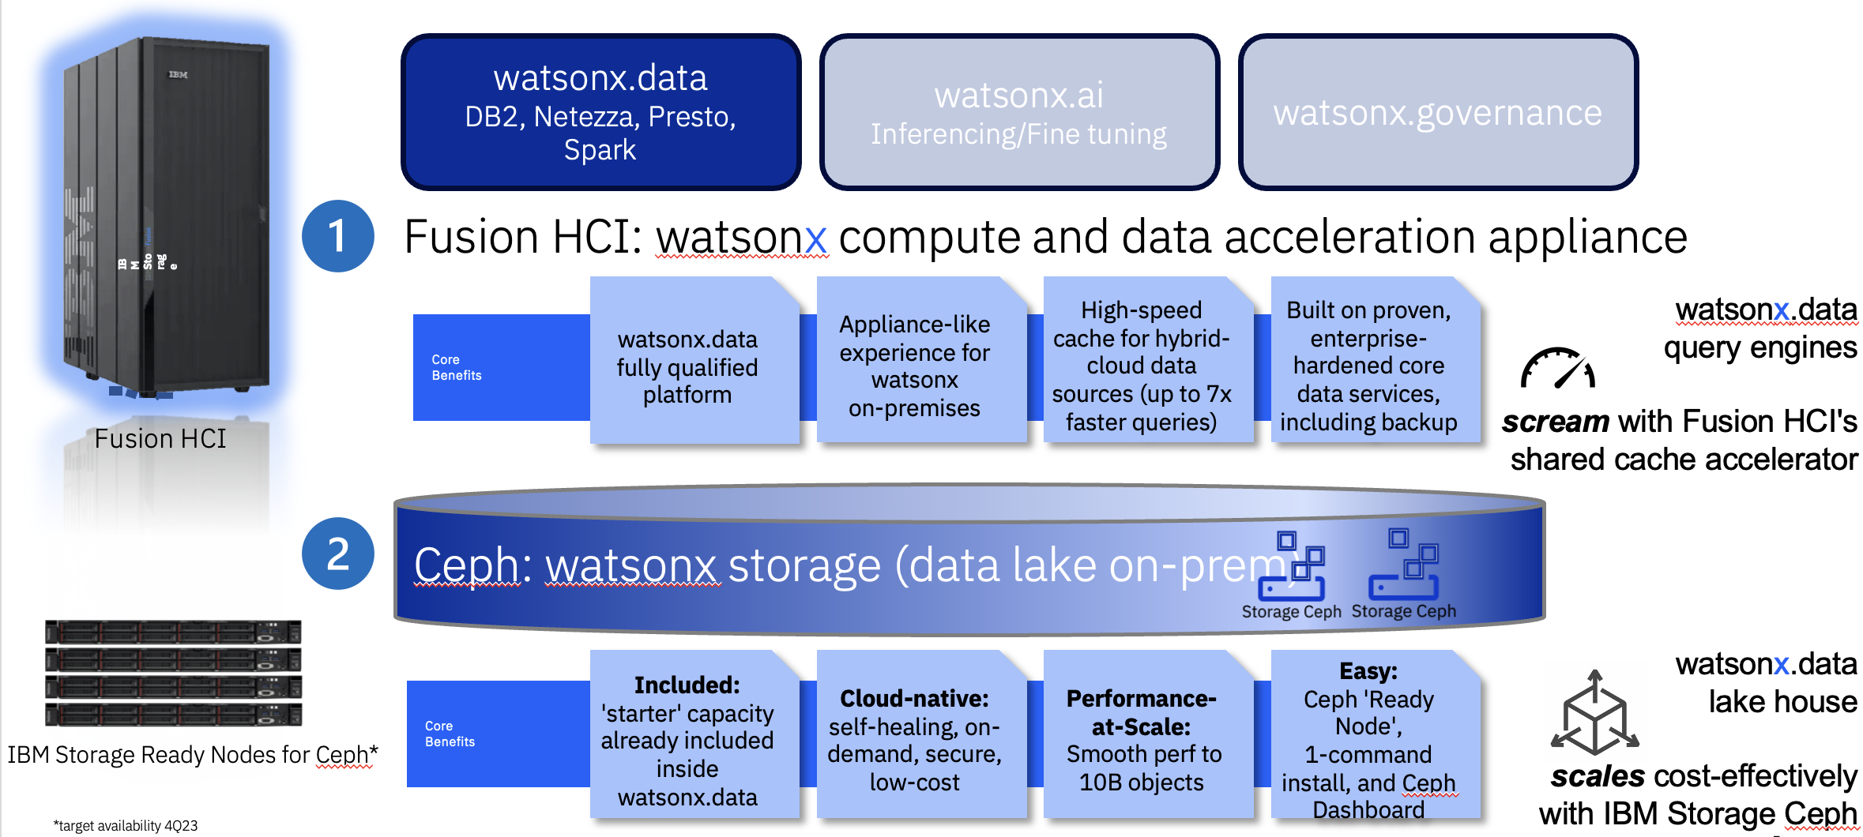
Fusion HCI for watsonx
Notes:
Fusion HCI (Hyper-Converged Infrastructure) is a system that provides an appliance-like experience specially tailored for watsonx. Fusion HCI offers dramatic performance gain over commodity hardware and can accelerate queries for remote data sources.
Fusion HCI harnesses watsonx.data's capabilities, including databases like DB2, Netezza, and data processing tools such as Presto and Spark. It offers high-speed cache operations and up to 7x faster query performance for hybrid-cloud data sources. It also offers robust data services and backup solutions.
The chosen storage solution is Ceph which is pivotal for on-premises object store data lakes. Ceph's design is cloud-native, self-healing, on-demand, secure, and cost-effective. It scales smoothly to meet any enterprise's growing data demands with a performance-ready setup that's easy to manage through the Ceph Dashboard.

Slide 41
Fusion HCI for watsonx - Value proposition
watsonx in a box
Hardware architecture optimized for watsonx
No need to design/prove/maintain a custom architecture and deployment model
Time to value
Deploy the full solution in under a week
Automated OpenShift install
Storage pre-configured for running Cloud Pak for Data
Simplified Day 2 UX
Orchestrated firmware upgrades
Orchestrated scale out/up
Integrated appliance monitoring/management experience
High performance
watsonx.data storage acceleration improves query times by 7-90x
NVMe cache shared by all query engines and nodes
Dedicated 100 GbE storage network
Enterprise ready
Highly available storage and networking
Backup & restore – built in for recovering from data loss or corruption
Disaster recovery – built in for recovering from the loss of a data center
Service and support
Expert Labs installation
Technical account manager: concierge service for helping with the adoption of the solution and management of the appliance
Single point of entry into IBM for the entire solution
Notes:
Fusion HCI value proposition:
Watsonx in a box - Fusion HCI provides a hardware architecture that is fully optimized for Watsonx. It eliminates the need for to design, prove, maintain, or even think about custom architectures and deployment models. IBM delivers a turnkey solution that just works.
Time to value – With Fusion HCI clients can deploy the full solution in under a week with an automated OpenShift install. The storage comes pre-configured for running Cloud Pak for Data, streamlining the entire setup process.
Simplified Day 2 UX - The platform simplifies the complexities of post-deployment with orchestrated firmware upgrades and scalable solutions, both out and up. Fusion HCI ensures an integrated experience for appliance monitoring and management, making day-to-day operations smoother and more efficient.
High performance - Watsonx data storage acceleration dramatically improves query times, boosting them by 7 to 90 times the standard rate. This is supported by NVMe cache shared across all query engines and nodes, with a dedicated 100 GbE storage network, ensuring that your data handling is not just fast, but lightning-fast.
Enterprise ready – Fusion HCI offers highly available storage and networking, robust backup and restore capabilities, and comprehensive disaster recovery options.
Service and Support – IBM provides with Expert Labs installation, a dedicated technical account manager, and a concierge service that aids in the adoption and ongoing management of the solution. It's a comprehensive package providing a single point of entry into IBM for the entire solution.

Slide 42
Model IP indemnification
→ Model IP (Intellectual Property) indemnification refers to a legal protection mechanism where the provider of a software or technology model assures the client against legal disputes arising from the use of their intellectual property (IP).
→ To learn more about how IBM’s standard IP indemnification methods and where it stands against its competitors check this link.
Notes:
Link - https://ibm.seismic.com/Link/Content/DChT7j7jjTMCHGMMX3BDfM8qQ6b3

Slide 43
Notes:
This self-explanatory slide does not require speaker notes.

